Slide 1

Welcome to Aspiring Leaders Session 1 :
NSTU Structure, Roles & Responsibilities
Thursday, August 13th 9:00 – 10:10 a.m.
Facilitators:
Jeff Morse & Roxanna John
Executive Staff Officers
Member Services
Notes:
Introduction of Executive Staff Officers followed by the attendees introducing themselves, their local and position.

Slide 2
NSTU Mission Statement
As the unified voice for the advocacy and support of all its members, the NSTU promotes and advances the teaching profession and quality public education.

Slide 3
Union Membership
12. (1) Every teacher who has a permanent contract, a probationary contract or a term contract, within the meaning of the Education Act, with an education entity in a teaching, supervisory or other professional capacity relating to education shall be an active member of the Union unless the teacher is expelled therefrom or unless the teacher resigns by written notice addressed to the Union at its head office and mailed by prepaid registered post.
(1A) A manager is not a member of the Union and may not be determined to be a member of the Union by the Council pursuant to Section 6.
- Nova Scotia Teaching Profession Act
Notes:
Long-Term substitutes is not a terminology used by the union. It was created by the employer. LTS have no contracts.
1A. This refers to administration, some Regional Center Education (RCE) /Board staff and the Regional Executive Directors (RED)/Superintendents

Slide 4
Overview
Brief overview of NSTU structure;
Annual Council roles and responsibilities;
Provincial Executive roles and responsibilities;
Local roles and responsibilities;
School representative roles and responsibilities;
Staff roles and responsibilities;
Anything else you’d like to hear about/discuss? Please ask questions throughout.

Slide 5

Constitution
Policy
Operational Procedures
= Teaching Profession Act, By-Laws and Standing Orders (SO’s)
Union’s official position on topics
Specific directives for Policy implementation/operations
OP’s “belong” to Provincial Executive
Policy “belongs” to Annual Council
This Act “belongs” to Legislature, By-Laws and SO’s “belong” to Annual Council
Notes:
Constitution, Policy and Operational Procedures are on the NSTU Website – Show the guidebook

Slide 6
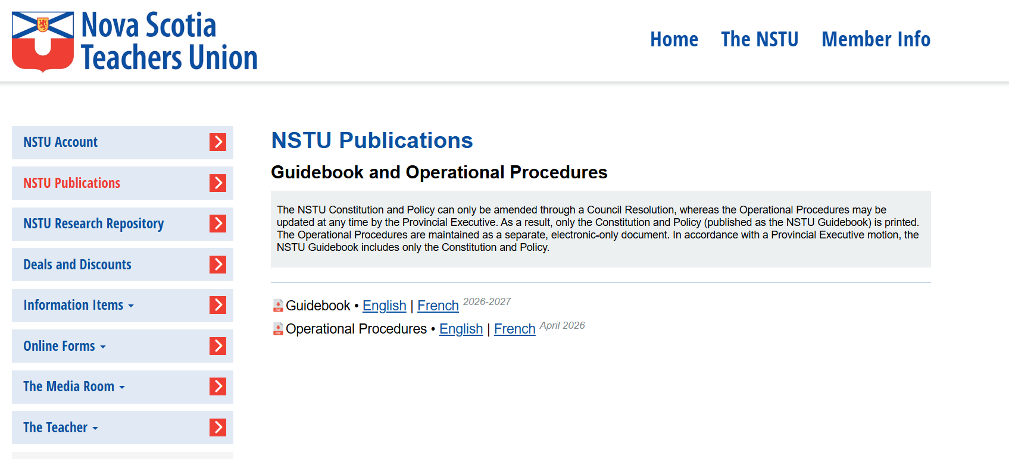

Slide 7
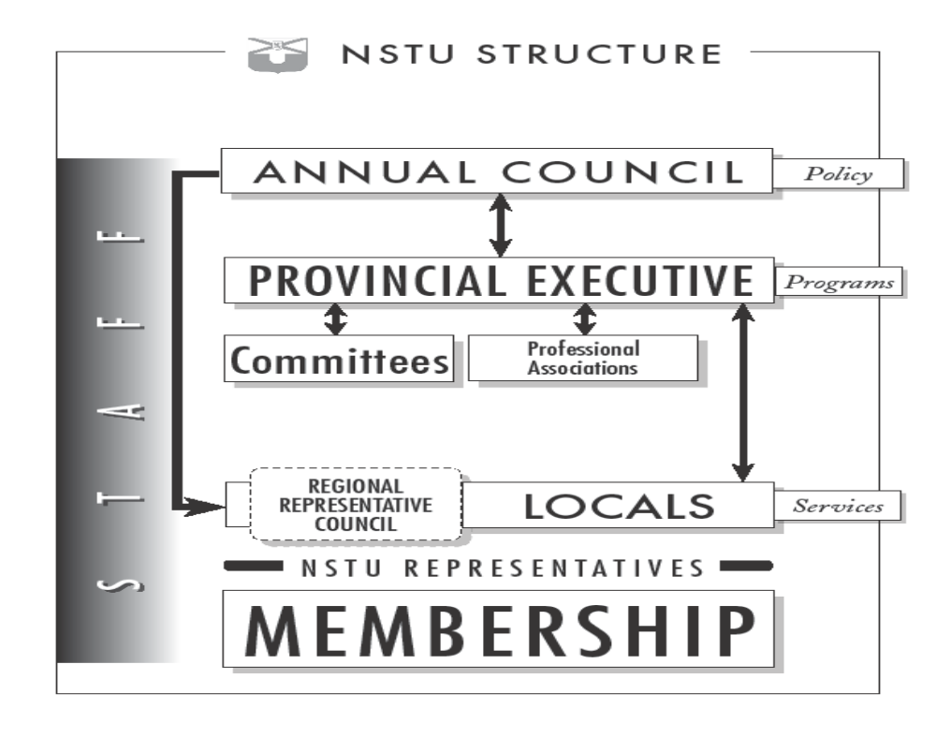
Notes:
Explain where everyone sits.

Slide 8
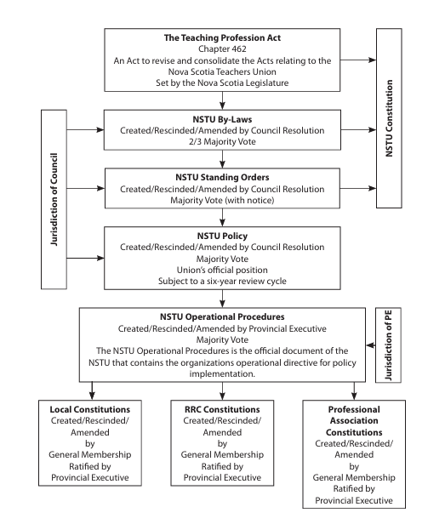
Notes:
Explain where everyone sits.

Slide 9
Provincial Level NSTU

Slide 10
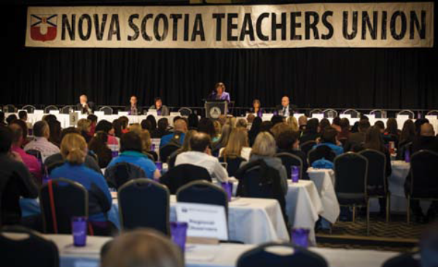
Roles & responsibilities – Council
The Council (“Annual Council”) is the policy-making, democratic governing body of the NSTU (supreme governing body)
Sets the direction and course for NSTU leaders and staff
Only place to change By-laws and Standing Orders
Composition
  Council delegates selected by Locals (1 voting delegate for each 50 members)
  1 Council delegate from each Professional Association
  Provincial Executive members
  RRC Chairpersons
  REWC Chairpersons
Notes:
RRC = Regional Representative Council
REWC – Regional Economic Welfare Committee

Slide 11
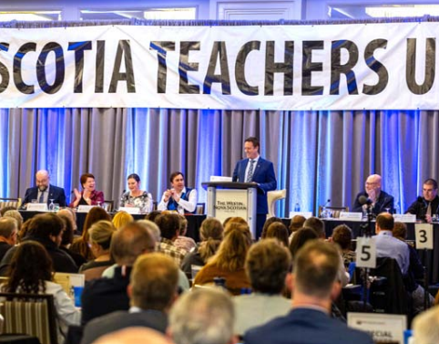
Roles & responsibilities – Council
Business
  Resolutions
  Budget
  Reports
  Committees of the Council (committees selected at and by Annual Council)
  Elections (e.g. First Vice-President every 2nd year, CTF delegates, Committee membership)
  Awards (e.g. Lifetime Membership Award, Special Award, Local Service Award)
Responsible to…the Teaching Profession Act
Notes:
CTF – Canadian Teachers' Federation. In french FCE = Fédération canadienne des enseignantes et des enseignants

Slide 12
NSTU President
(Peter Day)
The President is the official spokesperson for the NSTU and its negotiating team unless some other person has been specifically delegated with this authority.
Responsible for presiding at all meetings of the Council and of the Executive, and has general oversight of the affairs of these bodies
Ex officio member of all committees
Performs other duties as delegated by the Council or the Executive
Convenes a minimum of two conferences per year of NSTU Local Presidents and RRC Chairpersons
Notes:
Ex officio = by right of his position

Slide 13
Table officers
First-Vice President (Jo-Leigh MacPhee)
  Chairs Member Services Committee, Provincial Economic Welfare Committee, and Closed Sessions of PE meetings
  Member of Negotiating Team
  Delegate to AGM of Canadian Teachers’ Federation
  In the absence of the President, First Vice-President performs the duties of President
Second Vice-President (Janet O’Brien)
  Chairs Personnel Committee
  Chairs PE meeting in absence of First VP and President
Secretary-Treasurer (Lindsay Crossman Wheaton)
  Chairs Finance & Property Committee
  Provides audited Financial Statements and a proposed operating budget to Annual Council
Immediate Past President (N/A)
Notes:
Pic on the next slide

Slide 14

Composition
The Provincial Executive
President
Immediate Past-President
1st Vice-President
21 members elected on a regional basis at the local level, including 2 CSANE members and 1 APSEA member
The table officers of the Union are the President, 1st Vice-President, 2nd Vice-President, Secretary-Treasurer, and immediate Past-President.
The President is elected by a vote of the entire membership (universal suffrage).
The First Vice-President is elected by a majority vote during Council.
The Second Vice-President and Secretary-Treasurer are elected by the PE from among the 21 regional members.

Slide 15
Roles & responsibilities –
Provincial Executive
Functions in the name of the Council by directing and supervising the business, property and affairs of the NSTU between Annual Councils

Slide 16
Roles & responsibilities –
Provincial Executive
Business/Duties
  Provides assistance with organizing Locals, RRCs, and Professional Associations, and ratifies their Constitutions
  Provide recommendation to membership regarding the acceptance or rejection on a tentative agreement
  Attend meetings (PE, RRC, Local, Leadership Institute, tentative agreement presentations, Annual Council)
  Review resolutions prior to Annual Council
  Appoint and oversee provincial committees
  Engage in such duties as assigned by PE
  Determine the boundaries of Locals
  Liaise between PE and the Local, providing effective two-way communication
  Hire and supervise Executive Director

Slide 17
Provincial Executive
Provincial Executive Meetings
  Reports (i.e. President, Executive Director, Table Officers, Personnel Committee, Financial)
  Facilitate the business of the NSTU (i.e. discuss, recommend, take action)
  Information items (i.e. correspondence such as a Thank-You letter)
Provincial Committees
  Provincial Standing Committees
  ad hoc, Coordination, and Other
While most members are elected regionally, the PE is responsible to make decisions in the best interests of the entire NSTU

Slide 18
Regional Level NSTU

Slide 19


ROLES & RESPONSIBILITIES – RRCs
Mandate
  To address bargaining unit issues for NSTU members employed with that education entity (school board)
  To follow policies of the Council and the directives of the Provincial Executive
Regions
  Annapolis Valley
  Chignecto
  Cape Breton-Victoria
  Halifax
  South Shore
  Strait
  Tri-County
Notes:
Regional Representative Councils (RRCs) represent the interest of NSTU Locals within the jurisdiction of regional centers for education, and include executive participation from the Local. They are responsible for maintenance of professional development and economic welfare benefits from each school board. (from NSTU website regarding RRCs)
The RRC shall establish a Standing Committee called the Regional Economic Welfare Committee (REWC) with membership consisting of 1st Vice-Presidents from each Local and other members as determined by the RRC to a maximum of 10 members
Membership on the REWC shall be established annually

Slide 20
ROLES & RESPONSIBILITIES – RRCs
Business
  Carry out the responsibilities as set out in the TPA and the Regional Collective Agreement between the employing school board and the NSTU
  Regional Constitution & Operational Procedures
  Committees (i.e. REWCs, Management-Teacher Committee, Article 60 PD Fund Committee, etc.)
RRCs shall not deal directly in matters of policy with the provincial government, the department of Early Childhood Development & Education, or other provincial organizations.
Responsible to…
the Provincial Executive
Notes:
Regional Representative Councils (RRCs) represent the interest of NSTU Locals within the jurisdiction of regional school boards, and include executive participation from the Local. They are responsible for maintenance of professional development and economic welfare benefits from each school board. (from NSTU website regarding RRCs)
The RRC shall establish a Standing Committee called the Regional Economic Welfare Committee (REWC) with membership consisting of 1st Vice-Presidents from each Local and other members as determined by the RRC to a maximum of 10 members
Membership on the REWC shall be established annually
Who are the RRC's responsible to?

Slide 21
Local Level NSTU

Slide 22
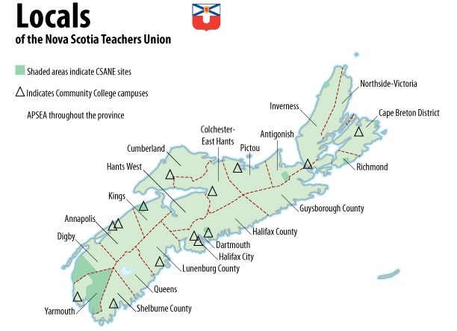
Locals
Notes:
Which locals belong to which region?

Slide 23
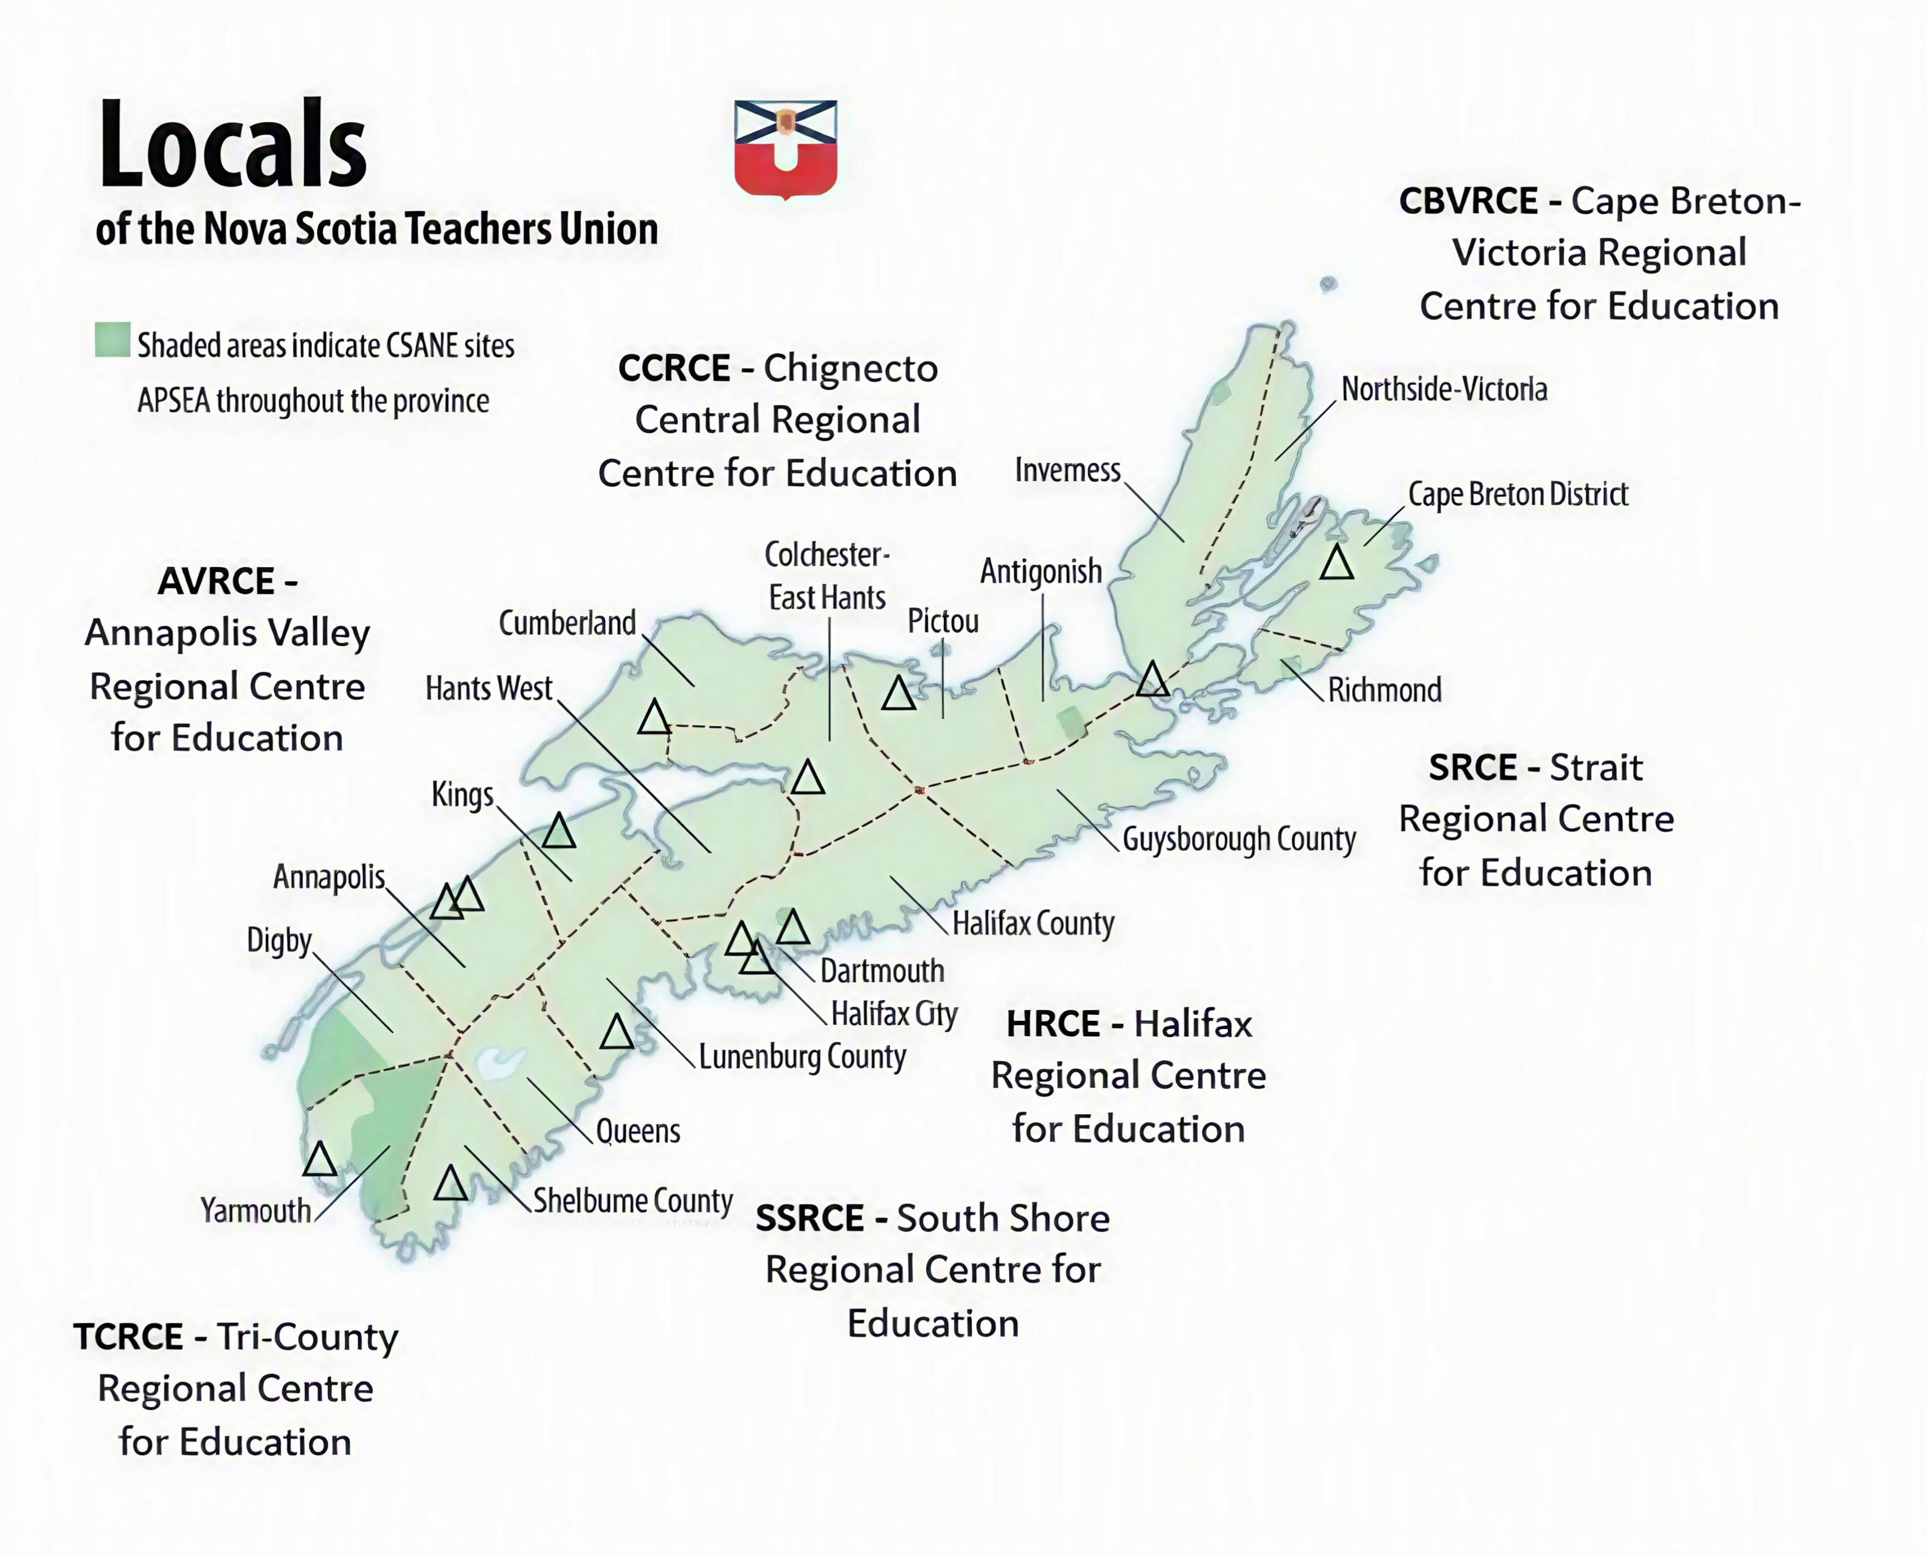
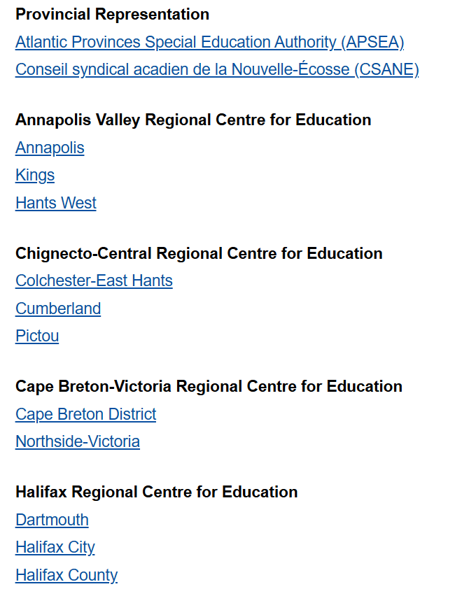
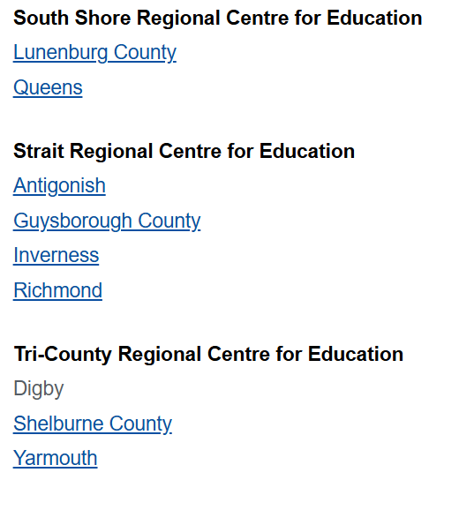
Locals

Slide 24
Locals
Mandate:
  The mandate of the Local shall be to advance and promote the teaching profession and the cause of education in Nova Scotia.
Business:
  Set Local Constitution & Operational Procedures.
  Set Local Committees (i.e., Finance, Nominating, Communications, Professional Development, Resolutions, and New Member).
  Local Executive is the governing body of the Local Union responsible for planning and implementation of the policies and directives of Council and the PE.
  Training of NSTU Representatives (10% of Local Budget)
  General Membership have the right to vote on all motions at General Local Meetings.
Notes:
Locals are created by the PE
Local Constitutions are established by PE
Locals are committees of the NSTU

Slide 25
PE members at local, RRC and general meetings
Local Executive Meeting
PE members are not members of any Local Executive. While they attend Local Executive meetings as part of their duty to be a “positive liaison and link between the Provincial Executive and the Local, providing effective two-way communication”, they should not move or second motions or vote.
RRC Meeting
PE members are regional members of their RRC with all rights and responsibilities of other members except the right to hold office.
Local General Meeting
PE members attend Local General meetings but can only make/second motions and vote if they are a member of the Local.

Slide 26
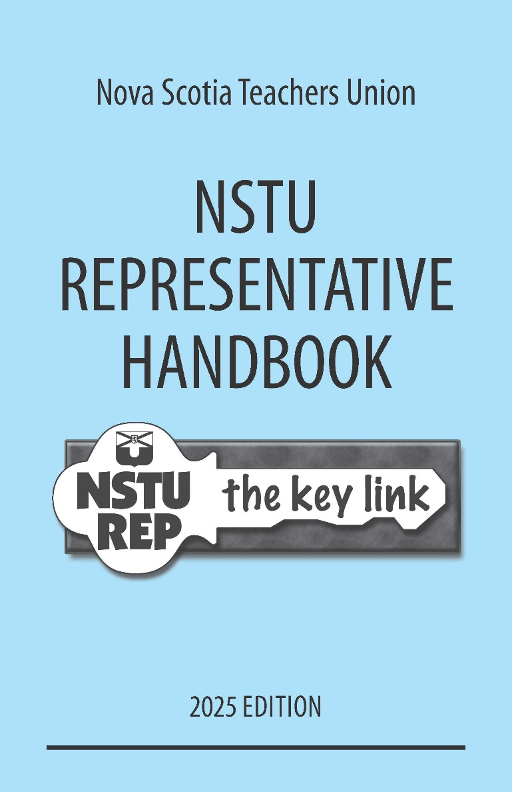
NSTU Reps
NSTU Rep Duties:
  Timely distribution and posting of NSTU information.
  Conduct Local, Regional, and Provincial votes at the worksite as directed.
  Coordinate the membership registry data collection at the worksite.
  Direct members’ requests to the appropriate Local or Provincial support person.
  Request time on staff meeting agenda for NSTU updates and call other meetings when necessary.
  Assist new members to become informed NSTU members.
Notes:
(from NSTU website)
NSTU Representatives
A NSTU representative is an active member of the NSTU assigned to an educational site within the geographical or educational site boundaries of the Local.
Each educational site shall elect a minimum of one NSTU representative. Educational sites with up to twenty-five (25) members may elect one representative. Educational sites with twenty-six (26) to fifty (50) members shall elect two; and educational sites with over fifty (50) members shall be entitled to the maximum of three representatives. The educational site shall be entitled to an equal number of alternate representatives.
Under exceptional circumstances, a Local General Meeting may approve additional NSTU representatives at an individual educational site.
The NSTU representative(s) shall be a member of the Local Council.
List of duties for NSTU representatives. Because of the importance of regular communication with our members,
two key duties are:
a. Timely distribution and posting of NSTU information received through the provincial NSTU representative network
b. Timely distribution and posting of information received from your NSTU Local.
The NSTU representative will be called upon to:
c. Direct members’ requests to the appropriate Local or provincial support persons.
d. Coordinate annual membership registry data collection in his/her educational site.
Because of the principal’s leadership role within the educational site, it is important to:
e. Keep the principal informed regarding NSTU matters.
f. Request time on the staff meeting agenda for NSTU updates.
The NSTU representative will also be expected to:
g. Call other meetings when necessary.
h. Assist new members to become informed NSTU members.
NSTU Operational Procedures
Membership Registry
Among the duties of an NSTU representative is the responsibility to keep the membership list for their site up-to-date within the Membership Registry. For further information on the Membership Registry and maintenance instructions click here.

Slide 27
Importance of the NSTU Site Rep
Your point of contact with the Union at your worksite.
If in your first teaching contract, they will assist you with the completion of the New Member Registration Form.
Don’t expect your rep to have all the answers, but they should be able to point you in the right direction, i.e., NS Pension Services, belairdirect Insurance, Provincial NSTU, Local NSTU, etc.
Never too early to become actively involved in your union and this is a great role to start that journey.
Update and maintain the Membership Registry for their site.
Should NOT offer contractual advice to members.
Notes:
Direct members to the NSTU webpage and use the search bar to assist teachers.

Slide 28
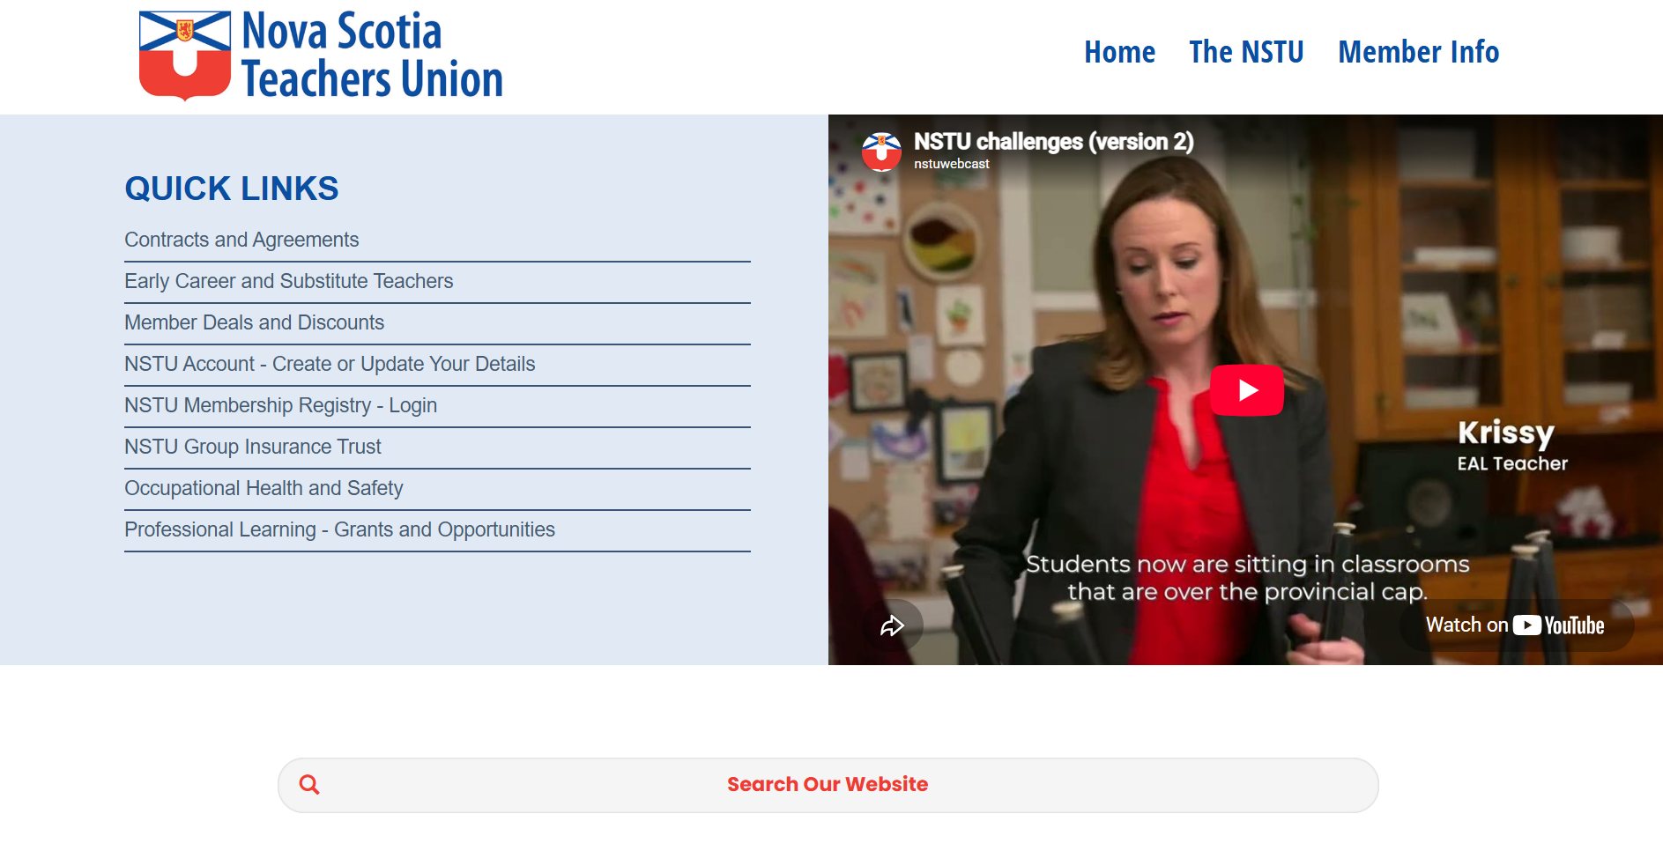

Slide 29
NSTU Staff

Slide 30
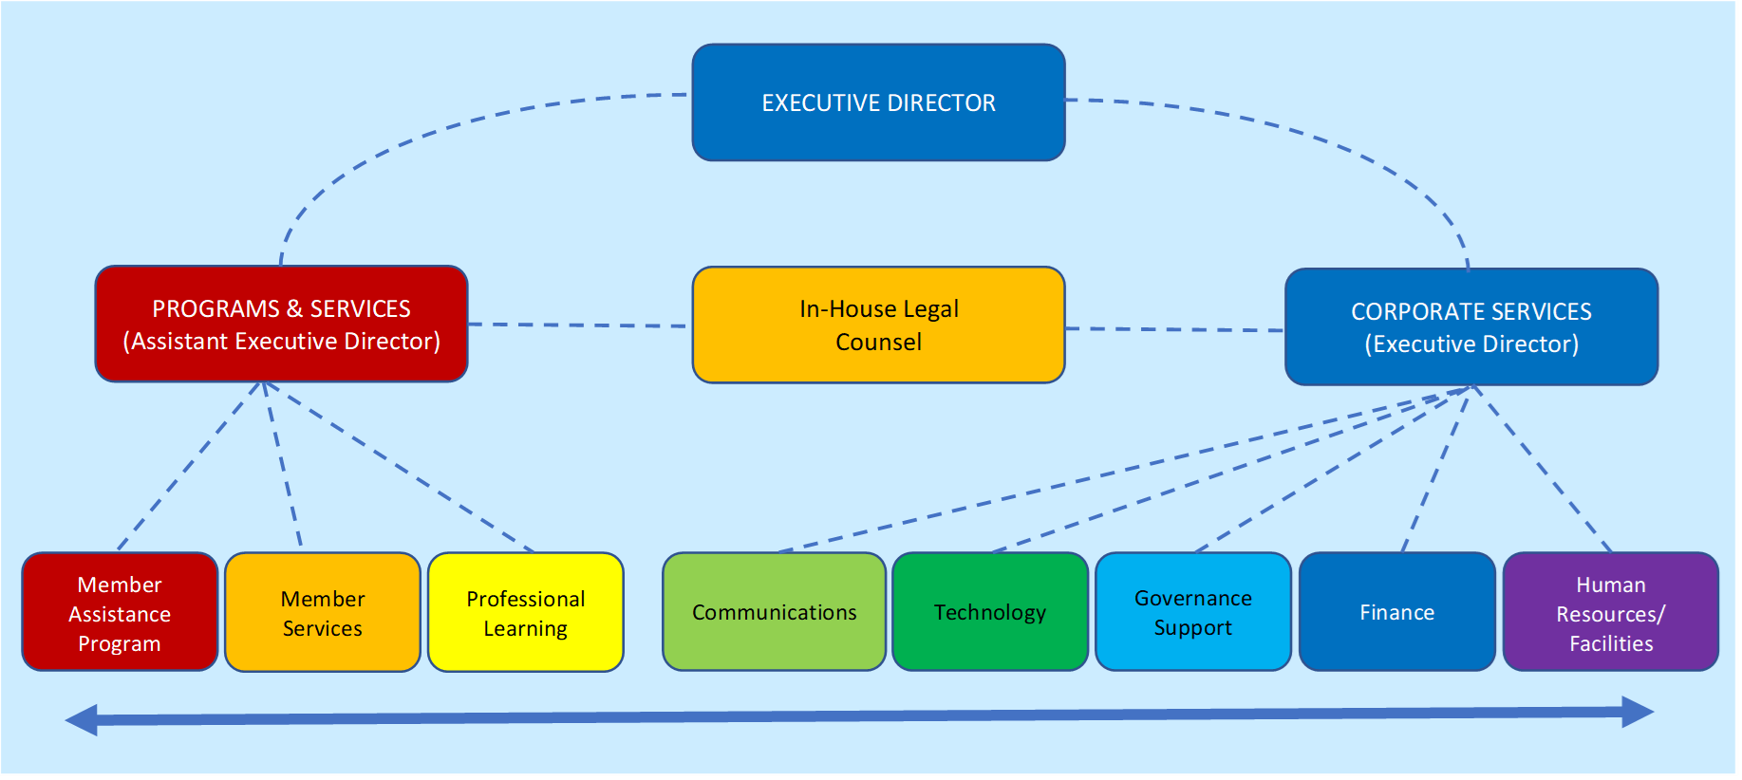
NSTU Staff departments

Slide 31

Roles & responsibilities – NSTU Staff
Directs and coordinates the activities and programs of the NSTU
Provides support to all levels of the NSTU structure and membership

Slide 32

Thank-you & Questions

Slide 33
Presented by
Jeff Morse
Executive Staff Officer
Member Services
Nova Scotia Teachers Union
E: jmorse@staff.nstu.ca
Roxanna John
Executive Staff Officer
Member Services
Nova Scotia Teachers Union
E: rjohn@staff.nstu.ca

