Slide 1
Role Session: Local Presidents,
RRC Chairs & Local First VPs
NSTU Leadership Conference
August 12 - 14, 2026
Presented by
Elizabeth Thomas – ethomas@staff.nstu.ca
NSTU Executive Staff Officer
Simon Wilkin – swilkin@staff.nstu.ca
NSTU Executive Staff Officer

Slide 2
Session Outline
Welcome and Introductions
Local and Regional Representative Handbook
Templates for Local and Regional Representative Operational Procedures and Constitution
Membership Registry update
Networking by Region and Roles
Additional Questions

Slide 3

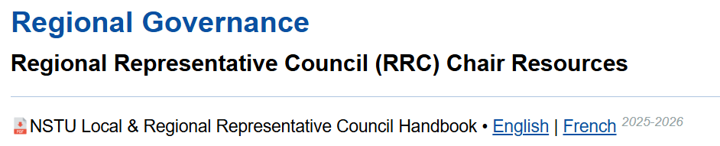
Local and Regional Representative Handbook
To access the resource, Local Presidents and RRC Chairs can:
Go to nstu.ca
 | click "The NSTU"
 |  | click "Structure"

Slide 4

NSTU Publications
Alternatively, the handbooks can be accessed by clicking on the publications link on our website:

Slide 5
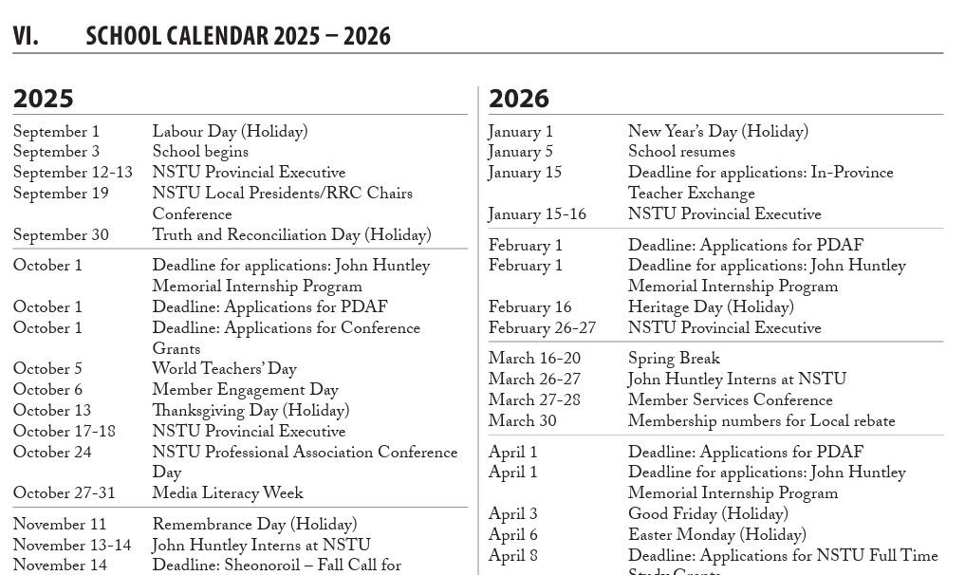
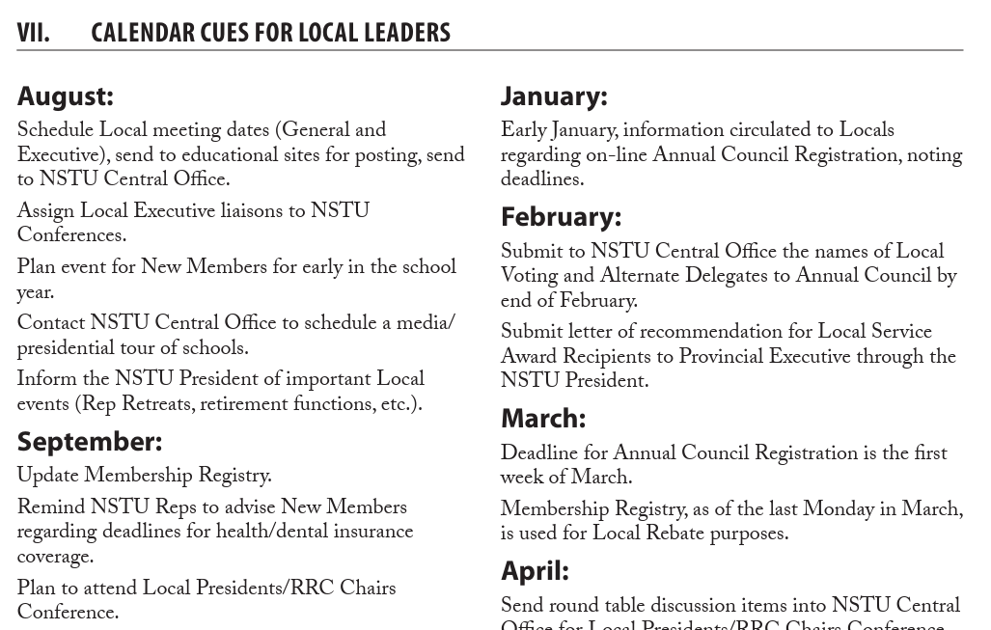
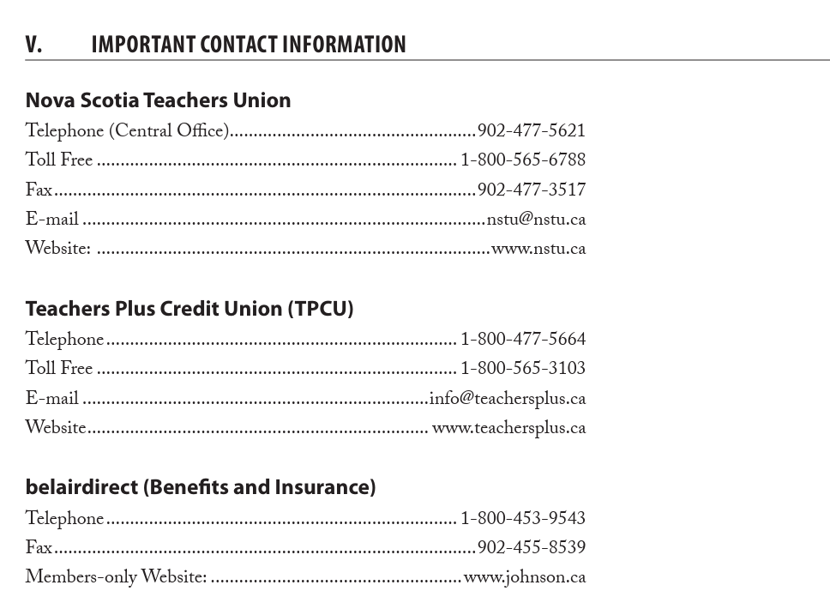
This resource includes:
Note:
An updated version will be presented when we meet in September 2026.

Slide 6
Templates for Local and Regional Representative Operational Procedures and Constitution
The Provincial Executive adopted new model constitutions and operational procedures for Locals and Regional Representative Councils.
Local Model templates can be accessed on the NSTU website under Local Presidents’ Resources which can be found at https://nstu.ca/the-nstu/structure/locals.
Regional Model templates can be accessed on the NSTU website under RRC Chair Resources which can be found at https://nstu.ca/thenstu/structure/regional-representative-councils.
If Local or Regional leaders require any assistance in updating their documents, they should contact Staff Officer Louis Robitaille (lrobitaille@staff.nstu.ca).

Slide 7
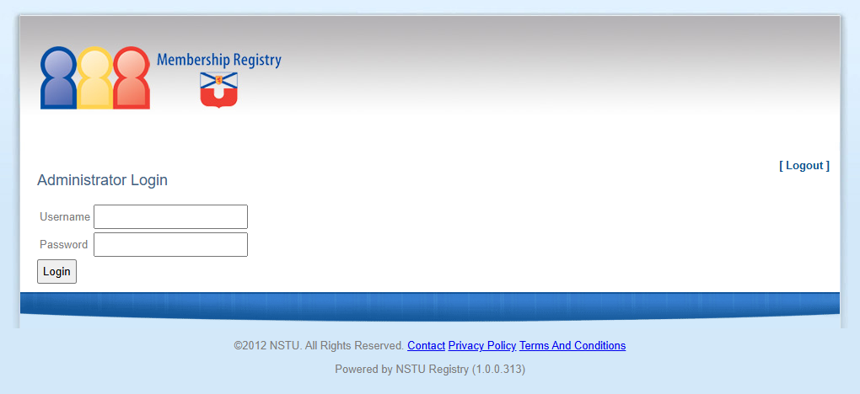
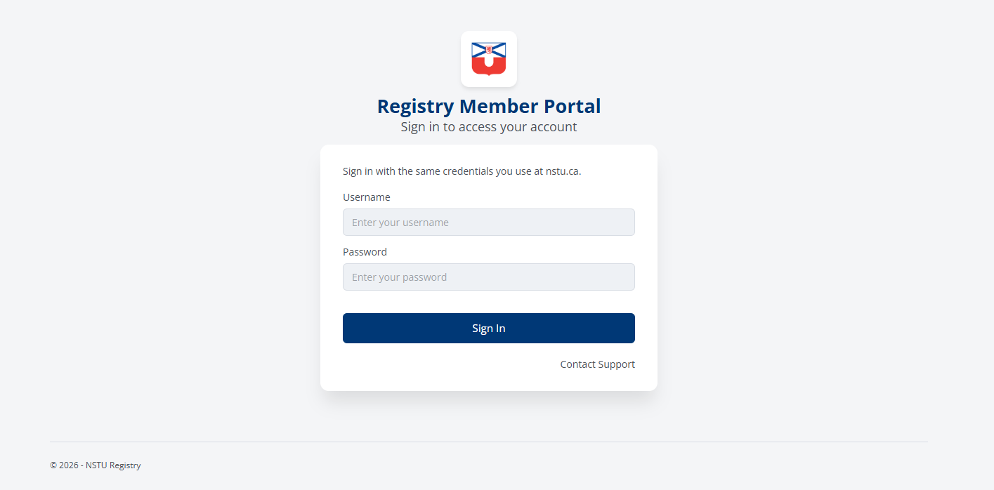
Membership Registry update

Slide 8
Networking by Region and Roles
Gather in groups by role - First VPs; RRC Chairs; Local Presidents and share:
One success from this year
One leadership challenge you are or anticipate facing
One idea or resource every leader should know about

Slide 9
Networking by Region and Roles
Gather in groups by Regions and share:
One idea from the role discussion
One issue unique to the region
One area you would like support in moving forward

Slide 10
Networking by Region and Roles
Leadership Marketplace - choose one of the topics you would like to further discuss:
Building Member Engagement
Dealing with Difficult Conversations
Running Effective meetings
Grievances and problem solving

Slide 11

Additional Questions?

