Slide 1
NOVA SCOTIA TEACHERS UNION
GROUP INSURANCE PRESENTATION
NSTU Leadership
August 2026

Slide 2
What’s Currently Available?
Benefit Presentations
NSTU Insurance Website
Individual Consultation
Retirement Seminars
RTO Presentations

Slide 3

Benefit Presentations

Slide 4
Benefit Presentations
These sessions are offered by request, typically planned by a Local or RRC, but also have presented to a school’s staff or group of teachers.
These presentation can be facilitated by one of the NSTU Group Insurance Trustees and/or the NSTU Staff Officer Liaison.
Typically, these are 1–2 hour sessions and a handout is provided for members.
These sessions can be presented in-person or virtually with the organizer responsible for any meeting space.

Slide 5
Benefit Presentations
There are a number of presentations relating to benefits available and they can be tailored to suit the organizer’s needs.
Presentations can cover broadly all active member benefits, retiree member benefits, or reserve member benefits.
They can also be focused on a specific benefit, such as the Employee and Family Assistance Program (EFAP).
Presentations can be stand-alone event or incorporated into a Local meeting, RRC Meeting, Rep Retreat, New Member Session, Substitute Session, etc.

Slide 6
Benefit Presentations
Please contact the NSTU Staff Officer Liaison or NSTU Group Insurance Trustee to arrange a presentation.
  Teacher Trustees:
    Halifax Region – Krissy Brewer – HalifaxTrustee@nstu.ca
    South Shore/Tri-County Region – Whitney Doucet – SouthShoreTriCountyTrustee@nstu.ca
    Chignecto Region – Wade VanSnick – ChignectoTrustee@nstu.ca
    Annapolis Region – Joanne Richardson-Landry – AnnapolisValleyTrustee@nstu.ca
    Cape Breton Region – Joël Chiasson – CapeBretonTrustee@nstu.ca
    Provincial Executive – Paula Landry – ProvincialTrustee@nstu.ca
  NSTU Staff Liaisons
    Staff Liaison Officer – Kyle Marryatt – kmarryatt@staff.nstu.ca
    Staff Liaison Officer – Paul Boudreau – pboudreau@staff.nstu.ca

Slide 7
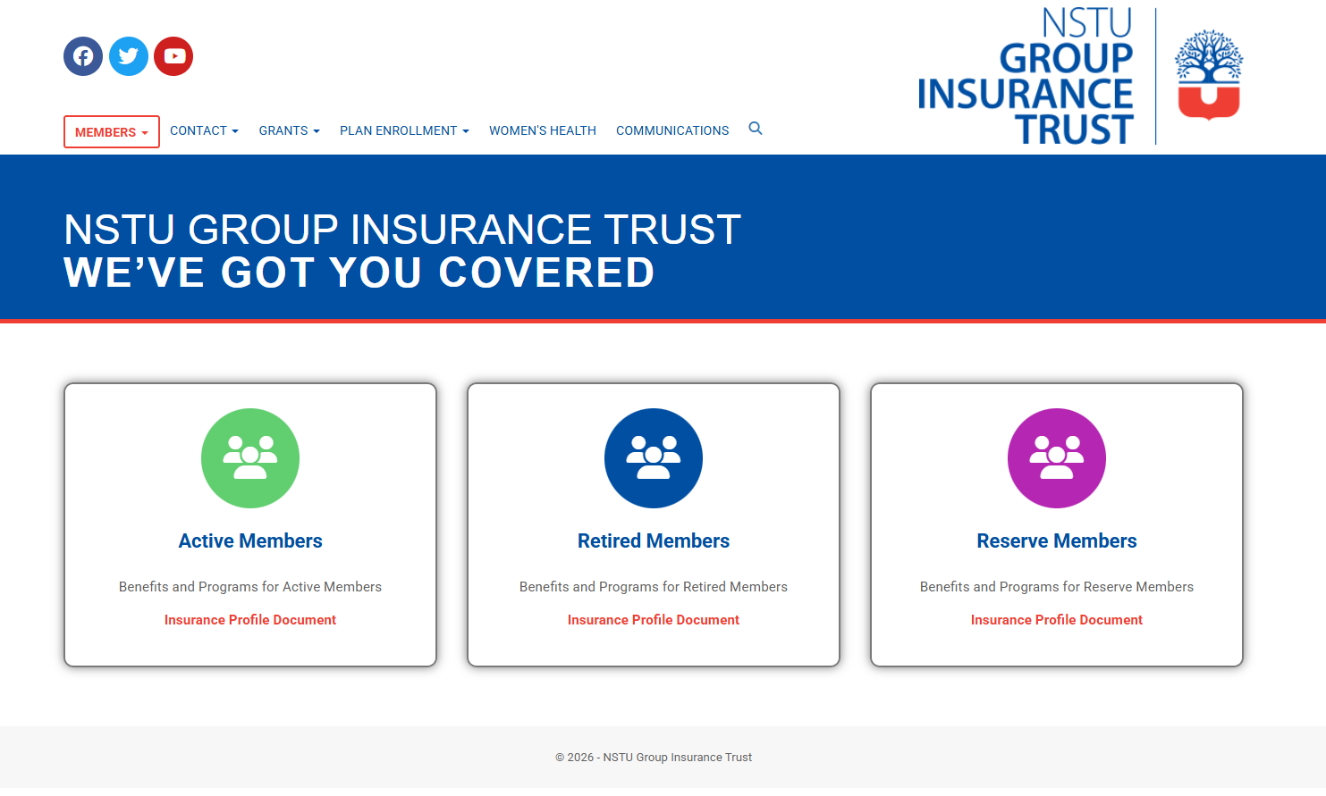
NSTU Insurance Website

Slide 8
NSTU Insurance Website
The NSTU Group Insurance Trustees have a website specifically focused on providing benefit related information to all Plan Members.
www.nstuinsurance.ca.ca
The website is designed to allow members to easily find the benefits available to them, based on their status – Active, Retired or Reserve.
Members can review their Insurance Profile (different for each status) and search for specific details relating to their Total Care Medical, Total Care Dental and other benefits.

Slide 9
NSTU Insurance Website
Contact information for the NSTU Group Insurance Trustees, the NSTU Member Assistance Program and belairdirect (our third-party administrator) can be found on the website.
Information about the Student Mental Heath and Wellness Grants and the EDUWellness Grants can also be found on the website.
To assist new members with plan enrollment, information can be found here which reflects the details relayed by belairdirect.

Slide 10
NSTU Insurance Website
The NSTU Group Insurance Trustees have also recently added a section focused on women’s health. This information brings together the women’s health related benefits, resources and supports available through the NSTU Group Insurance Plan. The information provided is intended to help members better understand the services, programs, and coverages that may support their physical, mental, and overall well-being.

Slide 11

Individual Consultations

Slide 12
Individual Consultations
When requested by individual members, the NSTU Staff Officer Liaison can meet with members to discuss their specific benefit related questions/scenario. These can be in-person, over the phone, via email or virtual.
Members can also contact belairdirect (1-800-453-9543) as they are our third-party administrator with any questions or when life events occur.

Slide 13

Retirement Seminars

Slide 14
Retirement Seminars
Members who are within five (5) years of retirement are eligible to register for, and attend, a two (2) day seminar focused on retirement. The leave is part of the Teachers’ Provincial Agreement and approved by the Education Entity.
While the focus is on your pension, there is also a session focused on retiree benefits. This session is facilitated by our Senior Consultant at belairdirect. The session includes a review of members’ current benefit options and how, if at all, these may change when a member retires – and whether they do so under or over age 65.

Slide 15

RTO Presentations

Slide 16
RTO Presentations
Similar to the presentations offered to active members, the Retired Teachers Organization may offer sessions to their members. These are facilitated by NSTU Staff Officer assigned to insurance, Senior Consultant at belairdirect, and/or other individuals, such as a representative from Homewood Health (EFAP), depending on the topic.
These presentations are arranged through the NSTU Staff Officer assigned to insurance in conjunction with the RTO.

Slide 17


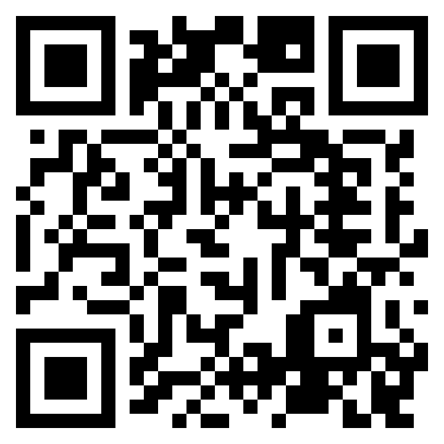

Resources

Slide 18
Required paperwork
This presentation is for information only.
Benefits have been described in brief.
Although every effort has been made to ensure that the information presented in this presentation is accurate, if there are variations between the information and the provisions of the policy or insurance contract, the policy/contract will prevail.
Complete W2 form
Direct deposit form
Employee Handbook acknowledgement
Thank You!
Insurance coverage enrollment
Retirement selection
Workplace training

