Slide 1

Planning Effective
NSTU Representative Training
Concurrent Session 4
Thursday, August 13
2:30-3:40 pm

Slide 2
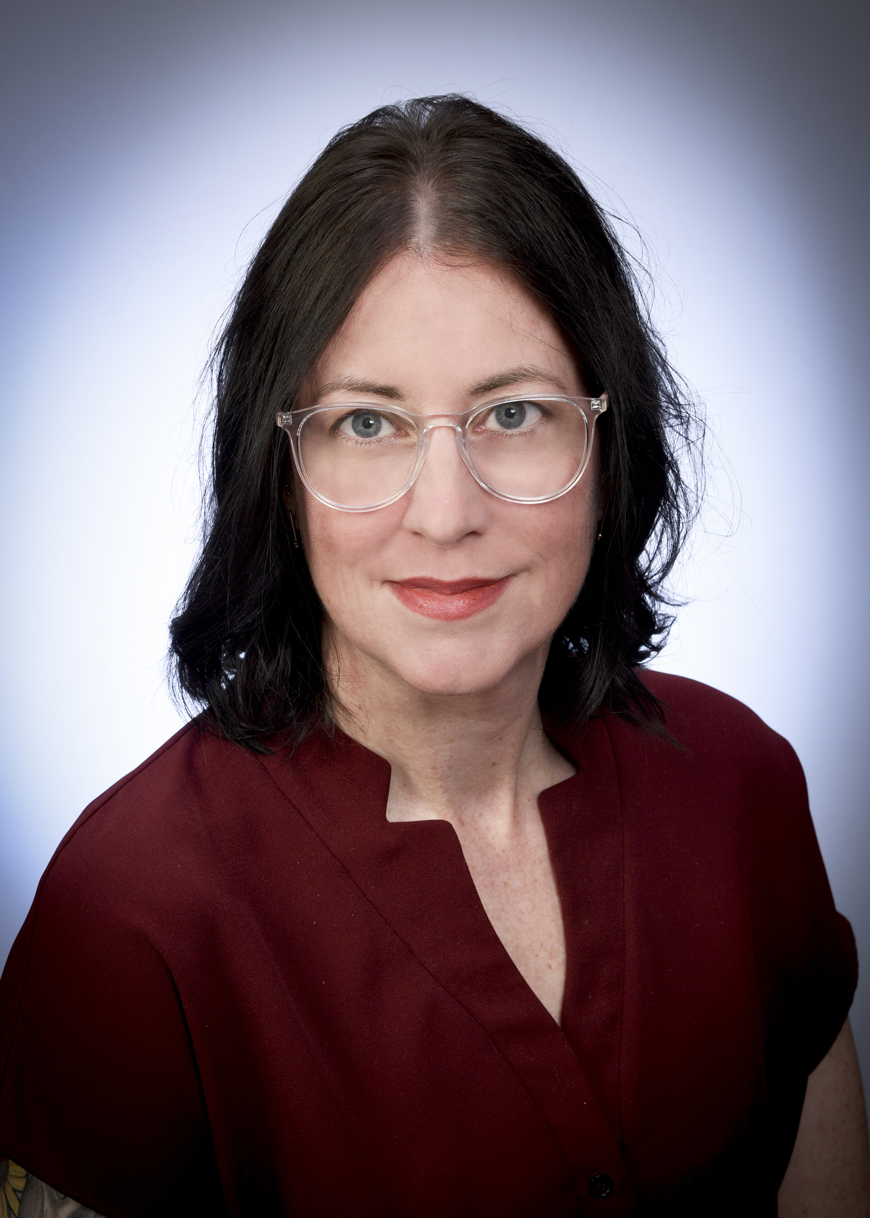
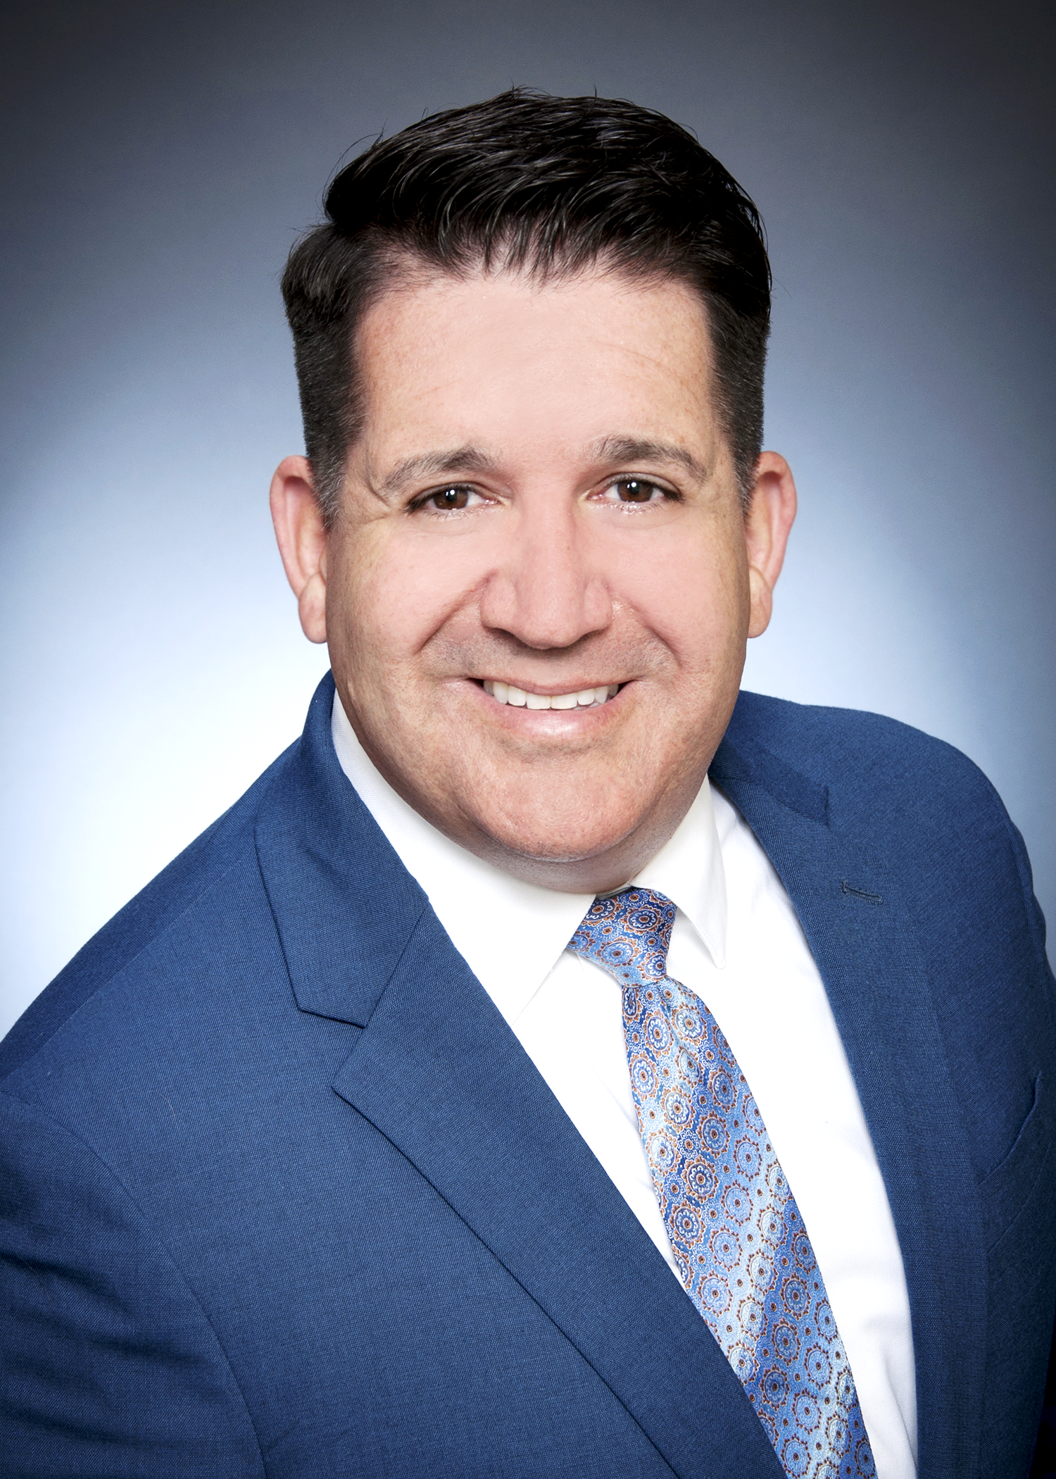
facilitators
Elizabeth Thomas
Executive Staff Officer
Member Services
ethomas@staff.nstu.ca
Tim MacLeod
Executive Staff Officer
Member Services
tmacleod@staff.nstu.ca

Slide 3
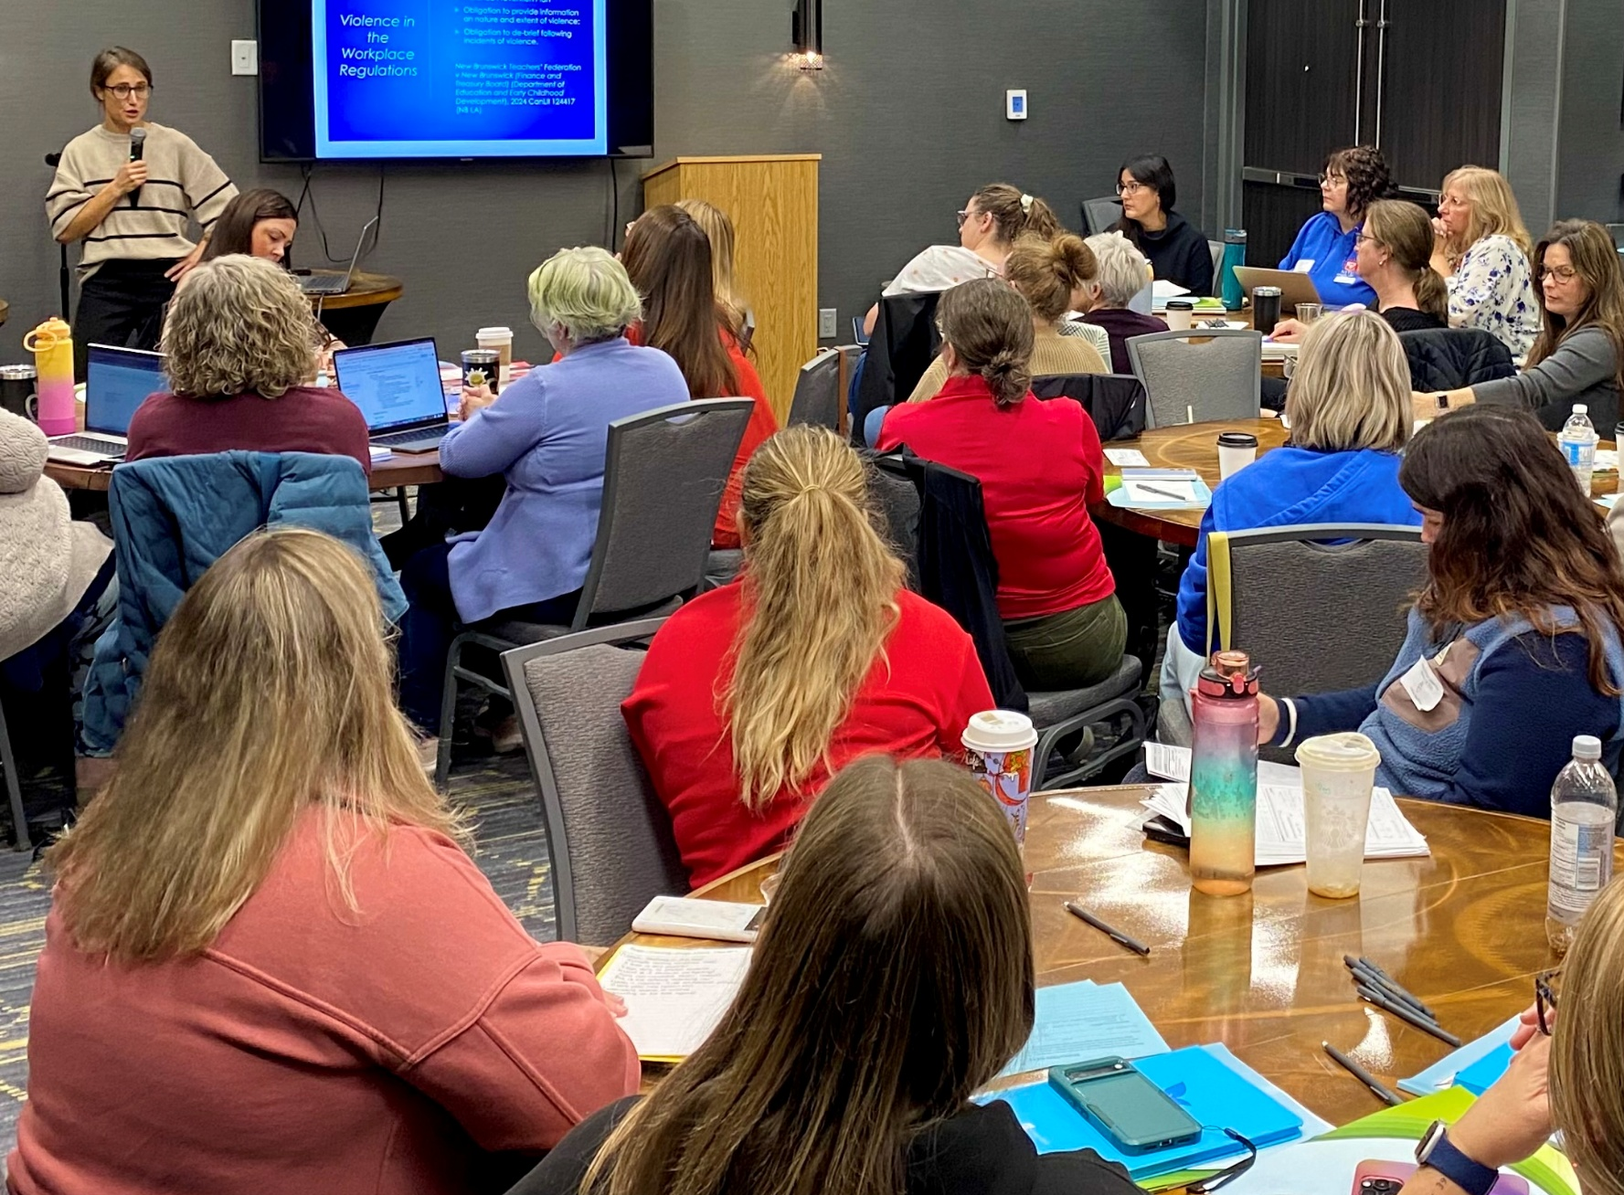
Planning Effective Representative Training
Concurrent Session 4 – Thursday 2:30-3:40 pm
Designed for Local Leaders responsible for planning NSTU Representative training, this session will use a train-the-trainer model to explore effective approaches to Representative development. A minimum of ten percent (10%) of each Local’s budget is designated for NSTU Representative training, whether delivered through Local Meetings throughout the year or through dedicated events such as a Rep Retreat. This session will highlight best practices that help build Representatives’ knowledge and strengthen the skills needed to effectively carry out their role.

Slide 4

Role of the NSTU Representative
Election of the NSTU Representative
Duties of the NSTU Representative
How can we support our NSTU Representative
NSTU Representative Checklist
Questions or Comments?

Slide 5
NSTU Representative Role: Disseminating information and directing member requests
- Article V of the Model Local Constitution
An NSTU Representative is an Active Member of the NSTU assigned to an educational site within the geographical or educational site boundaries of the Local.
The number of NSTU Representatives per educational site is based on a formula outlined in the NSTU Operational Procedures.
NSTU Representatives shall be elected according to election procedures outlined in NSTU Operational Procedures.
The NSTU Representative shall be responsible for such duties as outlined in NSTU Operational Procedures.
Notes:
The NSTU Rep is often the first contact for the NSTU.

Slide 6
The number of NSTU Representatives per educational site is based on a formula outlined in the NSTU Operational Procedures.
Every educational site must elect a minimum of one (1) NSTU representative
Each site is also entitled to an equal number of alternates
Site Membership | Maximum Representatives
Up to 25 members | 1 representative
26 – 50 members | 2 representatives
51 – 100 members | 3 representatives
100+ members | 4 representatives
Notes:
Local Executives should connect with the incumbent rep to ensure the is NSTU representation at each site.

Slide 7
NSTU Representatives shall be elected according to election procedures outlined in NSTU Operational Procedures.
Election Procedures for NSTU Representatives
Step 1 — Notice (On or Before First Day of School) The Local President notifies the
incumbent NSTU Representative at each site outlining:
      The procedure for electing new NSTU Representatives
      The duties and responsibilities of NSTU Representatives
Step 2 — Nominations (Within First Week of School)
      Nominations open for a minimum of 48 hours

Slide 8
Election Procedures for NSTU Representatives continued:
Step 3 — Election Meeting (First Working Day After Nominations Close)
Clear notice of the time, place, and purpose must be given to all members at the site
At the meeting:
  Nominees for Representative and Alternate are announced
  Three calls for further nominations are made before nominations close
  If nominations equal or are fewer than the number of positions allowed → candidates are acclaimed
  If nominations exceed the number of positions allowed → election by secret ballot
This process applies to both NSTU Representatives and Alternate Representatives

Slide 9

DUTIES OF THE
NSTU REPRESENTATIVE
- Model Local Operational Procedures -

Slide 10
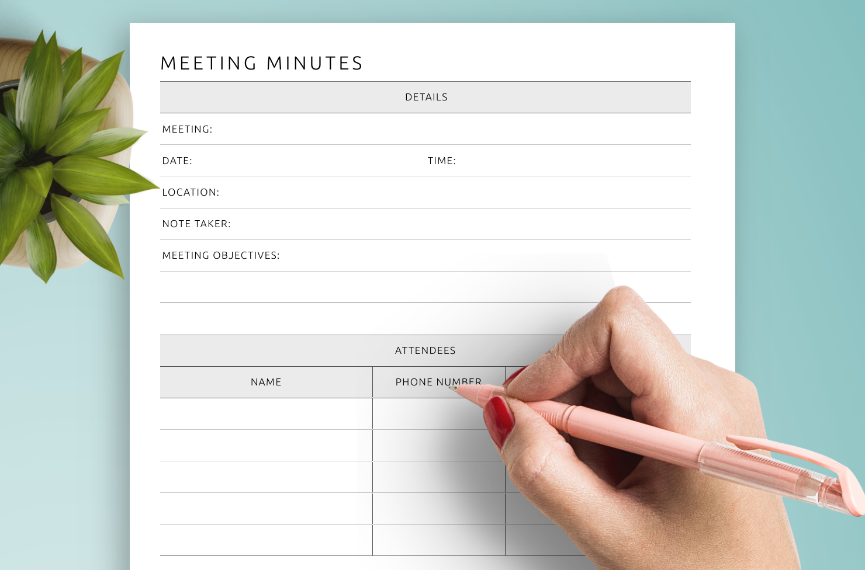
The NSTU representative shall request time on staff meeting agendas for NSTU updates.
In September, email the principal to ask to have NSTU Updates added to the staff meeting agenda as a standing item
NSTU information to highlight and share may be provided by your Local executive
What happens if the admin will not allow the NSTU Rep to have time on the agenda?

Slide 11

The NSTU Representative shall organize a minimum of three (3) meetings per year with the NSTU members at the educational site in order to:
  obtain NSTU members’ views on professional and economic welfare matters, and
  disseminate information to members concerning Local and Provincial matters.
It could be collecting information as a lead up to bargaining or gathering ideas from the members in the school site for a resolution to Council or for an upcoming rep forum.
Notes:
If there is cause for sharing information in advance of a staff meeting or is an upcoming deadline, reps can call meetings to keep the members at their site up to date. Local executive can solicit ideas for desired training from their reps.

Slide 12
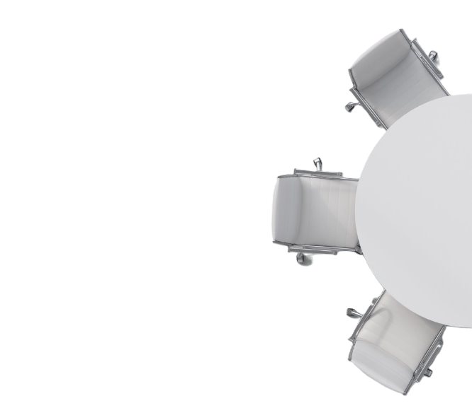
The NSTU Representative shall present the views and concerns of their educational site to the Local Executive.
NSTU Reps are the voice of the staff at a school/site — bringing forward concerns and questions to the Local Executive
Many Locals hold a Rep Forum as part of their general meeting agenda to provide this opportunity
Local Executive members attend RRC and Teacher-Management meetings to further advance these discussions at the regional level
Notes:
If a member comes to the rep with a specific concern, they should direct them to the Local President or the RRC Chair. In some situations, it may be important to have a member to understand deadlines (14 day from injury for IOD and regional grievance timelines) A member can connect with the MAP (MEMBER ASSISTANCE PROGRAM) by emailing nurse@nstu.ca.

Slide 13

The NSTU Representative shall be knowledgeable about the policies and procedures of the Local and the NSTU.
Following Council each year, the NSTU Guidebook is updated and made available both in print and electronically through the NSTU website
NSTU Operational Procedures are available online and updated by the Provincial Executive as changes are made
Local Constitutions and Operational Procedures should be available on each Local's website

Slide 14
The NSTU Representative shall direct member requests to the appropriate Local, Regional or Provincial authority.
Local
Local President and First Vice-president
A great starting point for Local and Regional matters
Regional
Regional Representative Council (RRC) Chair
For matters related to the regional collective agreement
Provincial
NSTU Executive Staff Officer
For matters related to the Teachers’ Provincial Agreement and to access information and supports through NSTU Central Office – Member Services, Professional Learning, MAP

Slide 15
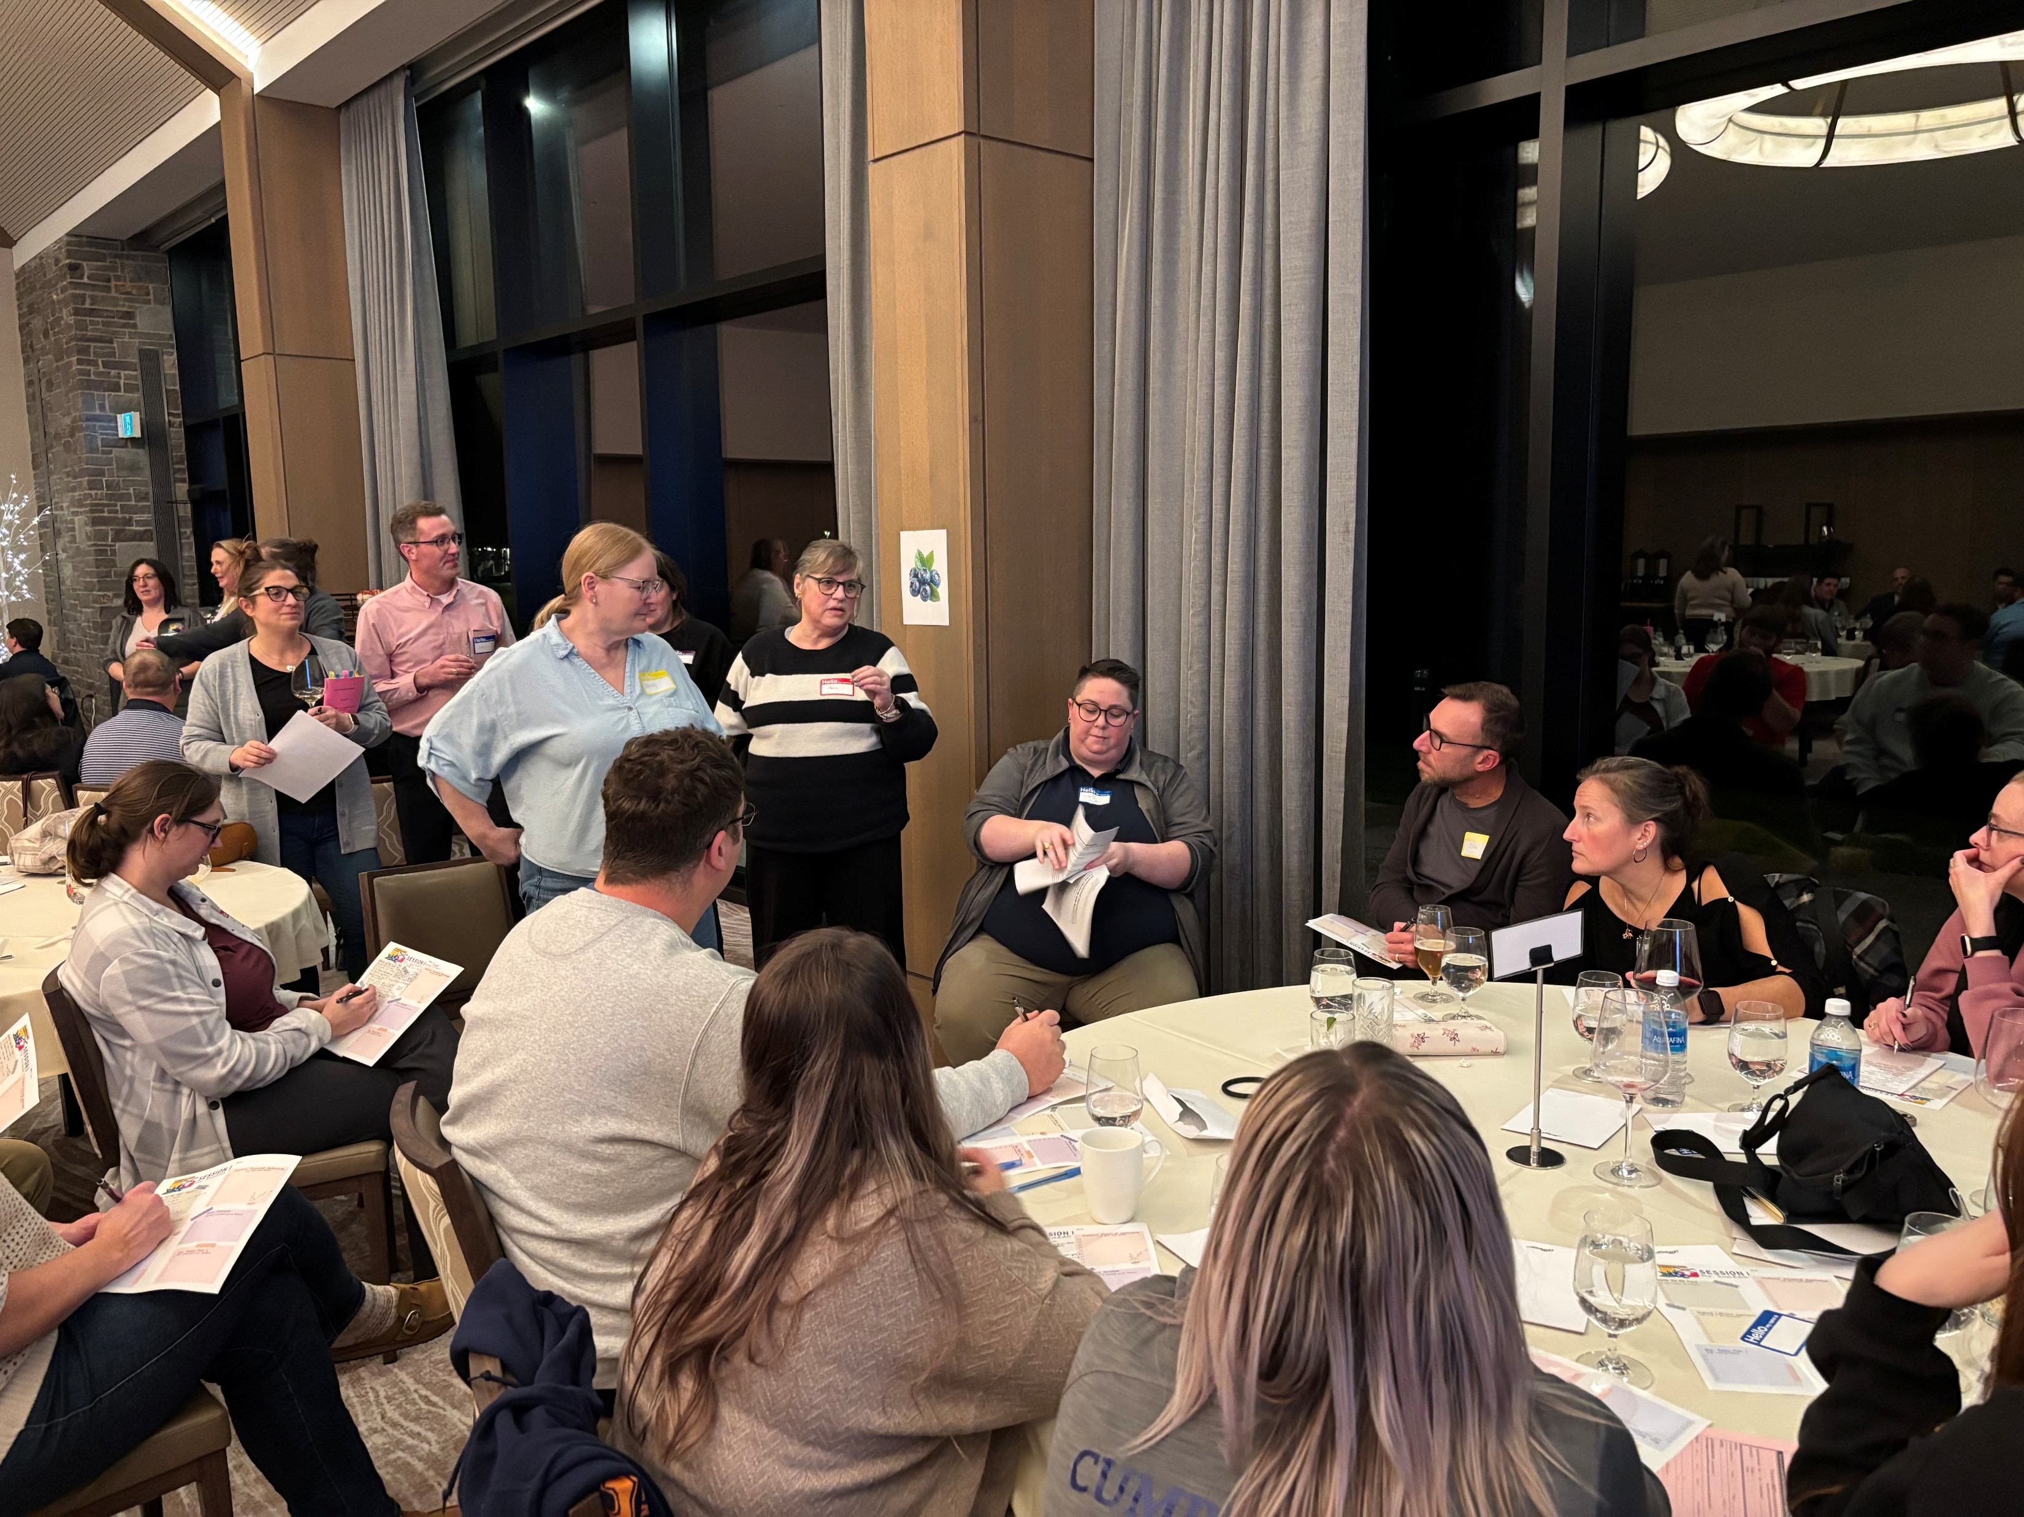

The NSTU Representative shall encourage new member involvement with Local activities.
Let’s take some time to share how this might be done.

Slide 16

The NSTU Representative shall attend General Meetings of the Local
The Local Executive rely on the NSTU site Representative being in attendance for the Local meetings. In addition to sharing the concerns/questions from the school site, the Local Executive use the local meeting agenda to share important updates, deadlines and other relevant information. The NSTU Representative plays an important role in getting information in the hands of the members at their site. This is particularly important in a year where there is collective bargaining taking place.

Slide 17

The NSTU Representative shall post agendas for General Meetings of the Local
An agenda may be distributed electronically in advance by the Local President, Secretary, or Communications representative and shared by the NSTU Rep — encouraging broader member attendance at meetings.
Notes:
Local Executives can send the draft agenda for local meetings to the reps up to a week in advance. Some local presidents will send out a call for agenda items to be able to research or get further clarification in advance of the meeting.

Slide 18

The NSTU Representative shall distribute material received from the Local, Regional or Provincial NSTU to members on site.
Electronic distribution and “hard-copy” materials on the NSTU bulletin board at your site
Promotional posters for NSTU sponsored events, contests, etc. (Local, Regional and Provincial)
Campaign materials leading up to elections
Voting cards
Othe information from the NSTU
Notes:
Article 60, although in the provincial agreement, is a regional committee. There are lots of opportunities available to NSTU members and members may have questions about reimbursement. Local presidents may choose to include important deadlines/dates on their agendas.

Slide 19
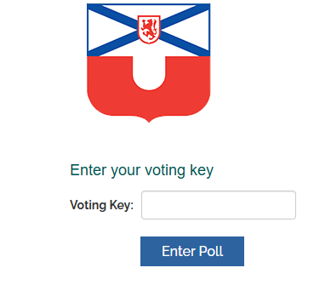
The NSTU Representative shall conduct educational site votes as directed by the Local, Region, or Provincial NSTU.
NSTU reps are responsible for ensuring all active members can cast a vote.
Coordinating in advance with the Returning officer to confirm receipt of voting cards and current registry list.
Ensuring that members who may be absent the day of the vote have their card and that sufficient cards remain for any reserve members or substitutes can also vote, if working the day of the vote
Returning signed lists and unused voting cards to central office.
Notes:
Leading up to a vote, it may be helpful to review the process for the vote including voting card checks, who the Returning Officer is, and who is eligible to vote.

Slide 20
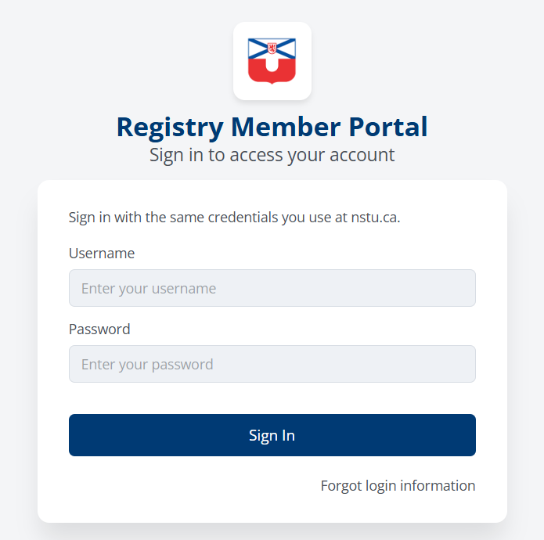
The NSTU Representative shall aide the Local Secretary in the collection of information for the Membership Registry.
The follow four (4) slides discuss this important function the NSTU Representative.

Slide 21

NSTU Membership Registry
NSTU Rep Duties:
  Timely coordination and collection of membership registry data at their educational site.
  Keep registry updated (terms, leaves, sabbaticals, happily retired, etc.).
  Help New Members enter their data into the registry.
  Important Deadlines of the first Monday in December for Annual Council delegation allotment and last Monday in March to determine Local Rebates.

Slide 22
NSTU Membership Registry
NSTU Representatives are encouraged to update the membership registry online in real time to ensure the Union’s membership database remains current and accurate.
Ideally, all site updates should be completed at least one week prior to each of the dates in December and March.
Updates may be completed any time prior to that point.

Slide 23
NSTU Membership Registry
The Membership Registry is important for three (3) reasons:
Determining representation at Annual Council (December)
Revenue for Locals and Regional Representative Councils (March)
Contact information for the NSTU. For example, staff in Member Services use the Membership Registry to document interactions with members

Slide 24
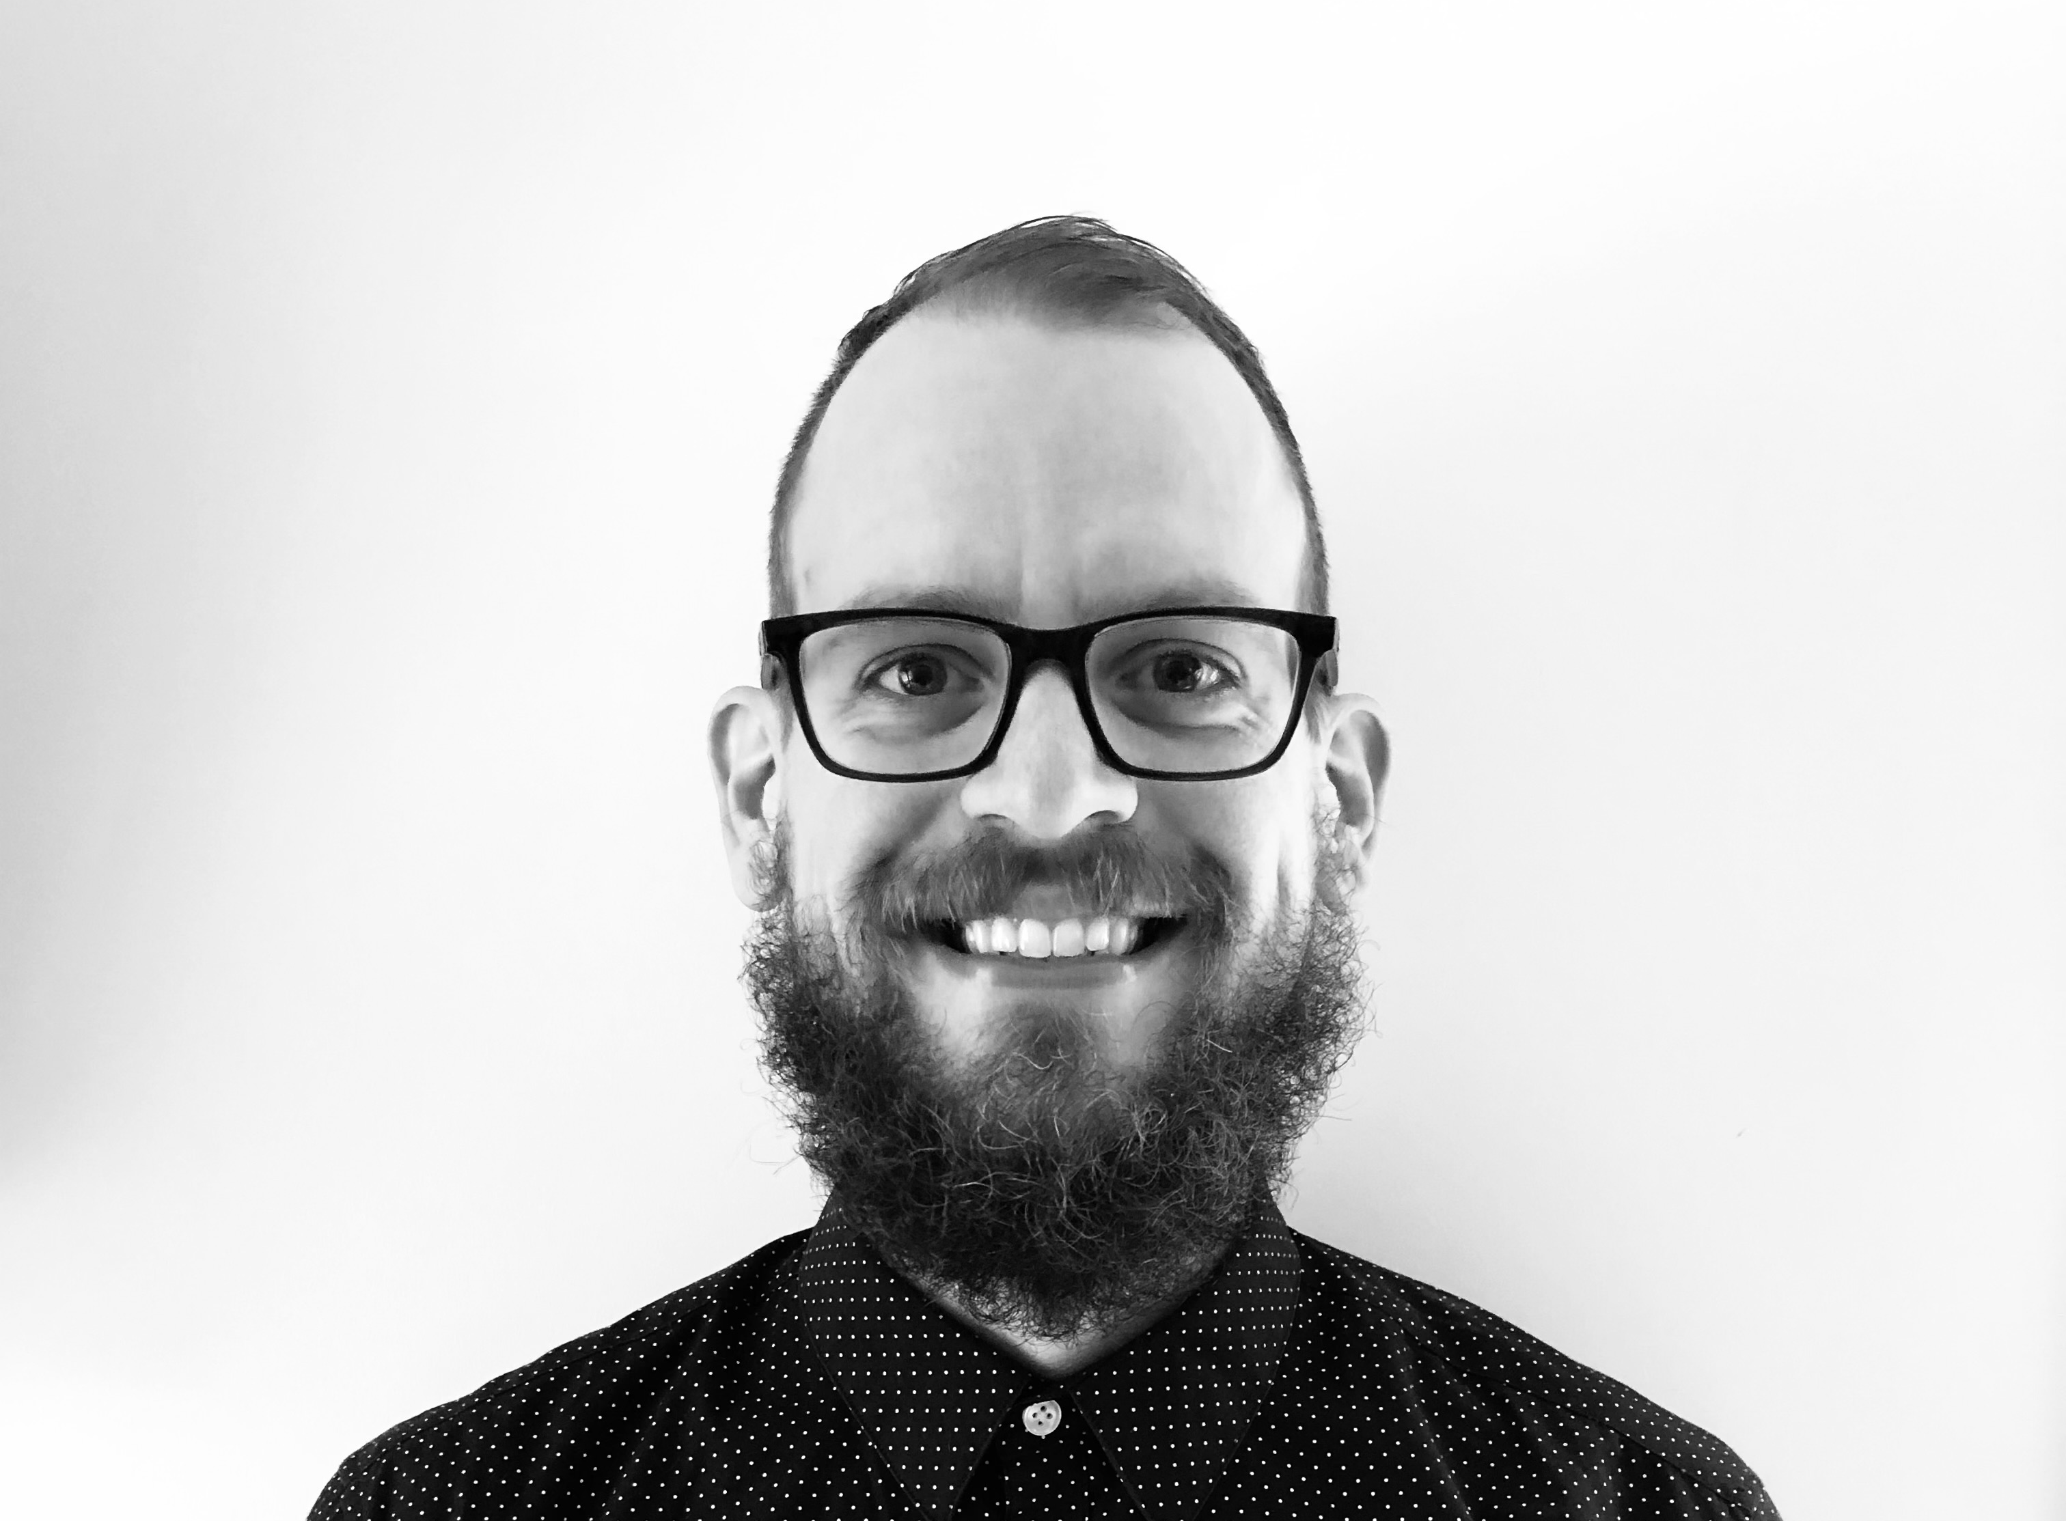
NSTU Membership Registry
If all else fails, contact our amazing IT Administrator, Jon Beram!
Local presidents, NSTU representatives and individual members can call or email Jon if they need assistance.
Phone: 1-800-565-6788 (toll free)
Email: webaccounts@nstu.ca

Slide 25
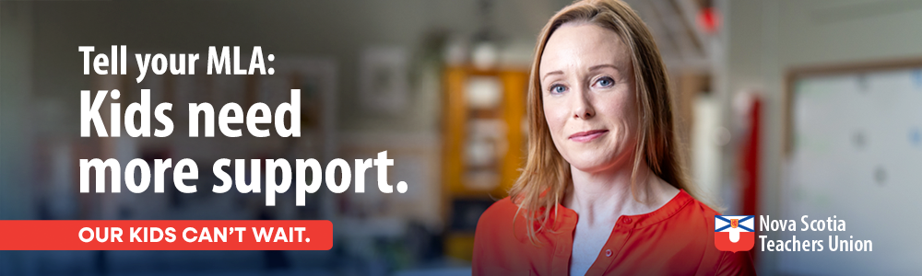
The NSTU Representative shall promote a united teaching profession.
Typically, this is supported by Professional Services Staff involving an initiative related to Public Affairs, Public Relations and Communications Programs
Re-sharing NSTU and Local social media posts

Slide 26
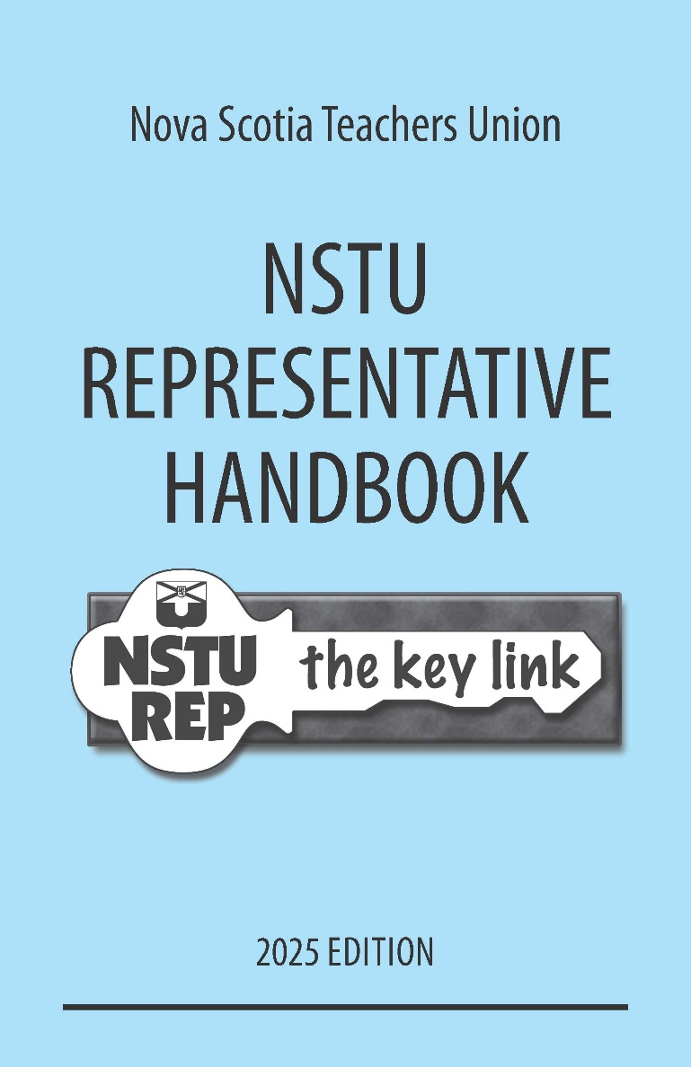

NSTU Publications
On the NSTU website, there are a variety of publications available to members, including the NSTU Representative handbook
https://nstu.ca/the-nstu/communications/nstu-publications
Notes:
Review Important dates on local meeting agendas. Some locals do a newsletter to highlight parts of the regional agreement and/or publications (ex. OHS) and resources (ex. nstuinsurance.ca) availabe.

Slide 27
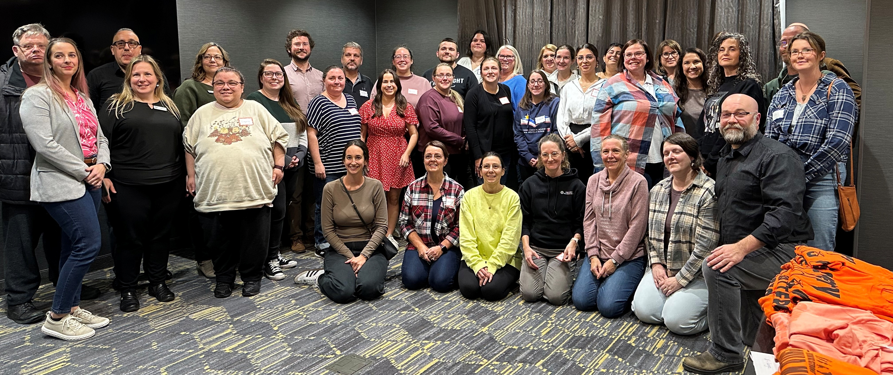
How we can support ouR NSTU Representatives

Slide 28
Discussion: How can we, as local leaders, support the NSTU rep?
Notes:
Review Important dates

Slide 29
It is NOT the role of the NSTU Rep
to act as the Union representation at any meeting which may result in discipline and/or be called for disciplinary purposes by supervisory personnel
to interpret either collective agreement for colleagues
to inform a member of their pension contributions and retirement date
to raise and pursue concerns with HR or administration on behalf of a member
Please ask reps to refer members to their Executive Staff Officer, Local President or RRC Chair.

Slide 30
CHECKLIST FOR NSTU REPS REGARDING NEW MEMBERS
Interactions with New Members at the Beginning of the School Year
Welcome new members and let them know you are the NSTU Representative for the site.
Remind new members to make sure their Membership Registry Profile is accurate (To register, complete the online Membership Information Form).
Remind New Members to make sure all their insurance forms are completed and submitted to belairdirect prior to October 15.
Remind New Members to make sure their registration for a Professional Associations Conference in October meets the deadline.
Inform New Members regarding when there are union activities and explain to them how to participate actively.
Suggest that New Members create a file for substitute teacher use.

Slide 31
CHECKLIST FOR NSTU REPS REGARDING NEW MEMBERS
At the beginning of the school year
Welcome new members and introduce yourself as the NSTU Representative for the site.
Encourage new members to review and update their Membership Registry Profile to ensure all information is accurate. Registration can be completed through the online Membership Information Form.
Remind new members to complete and submit all required insurance forms to belairdirect before October 15.
Ensure new members are aware of the deadline for registering for the Professional Associations Conference in October.
Keep new members informed about union activities and opportunities and encourage their active participation.
Recommend that new members create a substitute teacher information file to support continuity in their classroom when they are absent.

Slide 32

Thank-you & Questions

