Slide 1


Secretaries & Aspiring Leaders
Thursday Morning: Networking Session
10:30-11:40am
2026

Slide 2
In this session, Local Secretaries will come together with aspiring leaders. There will be opportunities to ask questions, connect aspiring leaders with current leaders, and learn more about the rewarding work of union leadership.

Slide 3
Guiding Questions
Introduction:
  Can you provide a brief introduction by sharing your name, the specific Local/Region you represent, the year you assumed your current position, and the primary responsibilities you hold within this Local/Region?
Achievements and Initiatives:
  Can you highlight some specific practices or initiatives under your purview within the Local/Region that you take particular pride in?

Slide 4
Guiding Questions… cont…
3. Challenges and Support:
  Are there any specific challenges you face in your role that you believe could benefit from the support and collaboration of your fellow colleagues?
4. Lessons Learned:
  Looking back, is there any knowledge or insight you've gained since taking on this role that you believe would have been especially beneficial to know when you first started?
5. Additional Inquiries:
  Do you have any additional questions or topics you'd like to discuss?

Slide 5
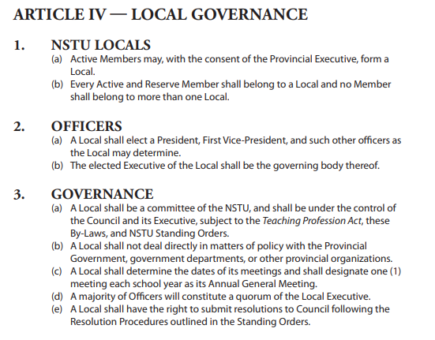

Slide 6



