Slide 1


Concurrent Session 3
Thursday, August 13, 2026
1:00 - 2:10 pm

Slide 2

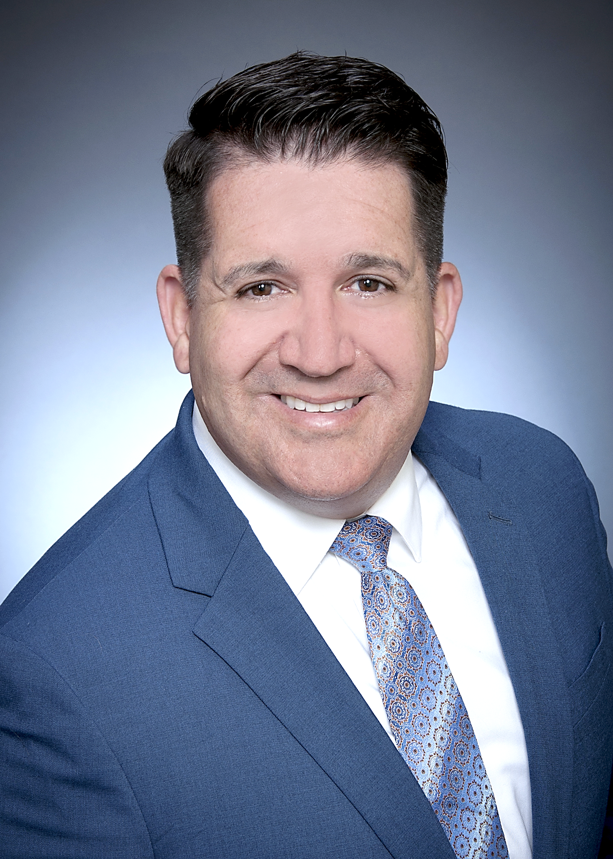
Today’s Facilitators
Leah kutcher
Tim MacLeod
In-house Legal Counsel
lkutcher@staff.nstu.ca
Executive Staff Officer
Member Services
tmacleod@staff.nstu.ca

Slide 3
Disclaimer
This is a summary of information provided solely for the purpose of explaining features of occupational health and safety. The most up-to-date information with respect to the Occupational Health and Safety Act and Regulations can be accessed through the Department of Labour and Advanced Education
https://novascotia.ca/lae/healthandsafety/
This presentation is not complete without commentary.

Slide 4
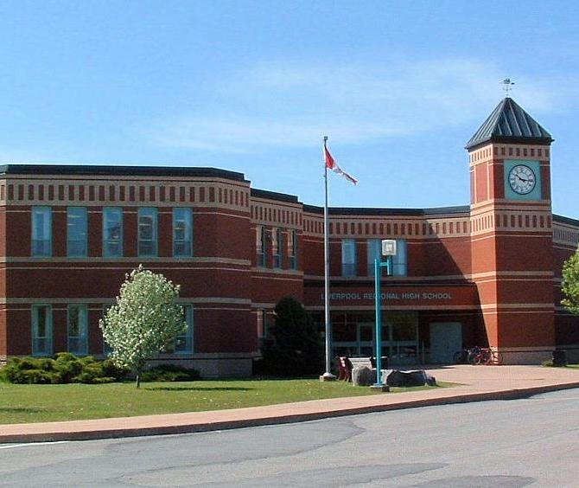
Occupational Health & Safety
In this presentation we will review how the Occupational Health and Safety Act maps onto the Education System. We will review the important right to know and the right to refuse work and look at specific health and safety issues teachers face in their schools.

Slide 5
Safe workplaces are created by people who care. Your health and safety in the workplace are protected by Nova Scotia’s Occupational Health and Safety Act and Regulations.
The goal at your workplace is to establish and enforce clear standards, procedures and protocols to reduce occupational injury and illness.

Slide 6
Empowering Union Leaders: Nova Scotia Occupational Health & Safety and Member Engagement
New role - NSTU OHS Team Lead
Purpose: build confidence in supporting members
Focus on practical action, not legal expertise

Slide 7
Being aware of the foundations of workplace health and safety helps us to better understand how to keep ourselves and others safer at work.
This includes:
awareness of workplace health & safety
an introduction to the Internal Responsibility System (IRS) and rights and responsibilities
thinking about duty of care and due diligence
Notes:
Duty of care refers to the legal obligation placed on workplace parties to take reasonable steps to protect the health, safety, and welfare of workers and others in the workplace.
The Act assigns duty of care broadly — it does not fall on employers alone. The key parties and their obligations are:
Employers carry the highest duty and must:
Ensure the health, safety, and welfare of every person in or at the workplace
Provide and maintain safe equipment, systems, and a safe work environment
Provide information, instruction, training, and supervision necessary to protect health and safety
Ensure that workers are aware of their rights and responsibilities under the Act
Workers must:
Take reasonable care to protect their own health and safety and that of others
Cooperate with the employer on health and safety matters
Report hazards and unsafe conditions
Due diligence is the legal defence available to an employer, supervisor, or other workplace party who has been charged with a violation of the OHS Act. It means that even if a violation occurred, the party can avoid liability if they can demonstrate that they took every reasonable precaution to prevent the incident or violation.
In Nova Scotia, due diligence generally requires proving one of two things:
1. The party reasonably believed in a mistaken set of facts that, if true, would have made the conduct innocent — and acted reasonably on that belief.
2. The party took all reasonable precautions to avoid the violation

Slide 8

Awareness of Workplace Health & Safety:
Legal information
Employers have a duty under section 13(1) of the Occupational Health and Safety Act to take every reasonable precaution to ensure the health and safety of persons at the workplace.

Slide 9
Why OHS Matters in Schools
Discussion
What OHS issue are you hearing about most often?
What are teachers facing?
Violence and aggression
Student behavioural incidents
Workload and burnout
Indoor air quality/temperature concerns
Slips, trips and falls
Harassment and bullying
Psychological strain

Slide 10
Duties Under the Act
Employers Must
Take every reasonable precaution
Identify and control hazards
Union Leaders Can
Support participation
Promote reporting
Workers Must
Work safely
Provide information, instruction and supervision
Connect members to resources
Follow procedures
Report hazards

Slide 11

The Three Worker Rights
Under the Act, you have a “voice”. The Act provides all employees with three basic rights. They are:
1) The Right To Know
You have a right to information on issues that affect your health and safety.

Slide 12

2) The Right To Refuse
You have the right to refuse unsafe or unhealthy work.

Slide 13

3) The Right To Participate
You have the right to participate in the selection of members of a Joint Occupational Health and Safety Committee or a Health and Safety Representative. You also have the right to report unsafe conditions and voice your concerns or opinions on any issue that affects your health and safety, or the health and safety of anyone at the workplace.

Slide 14
The Internal Responsibility System (IRS)
What is it?
A legal philosophy underpinning Canadian safety law that says everyone at the workplace has and shares responsibility for health and safety. Nova Scotia safety law says everyone shares responsibility for health and safety to the extent of their workplace authority and ability.

Slide 15
Employee Responsibilities
Employees have a duty to report anything in the workplace that they think may be dangerous. The report should be made to:
a supervisor (principal, vice principal)
the Joint Occupational Health and Safety Committee (JOHSC), if the supervisor does not fix the situation to the employee’s satisfaction
the Department of Labour and Advanced Education, if the JOHSC does not fix the situation to the employee’s satisfaction

Slide 16
Roles and Responsibilities of the
Joint Occupational Health & Safety Committee
Very generally, the role of the committee involves:
  inspections
  hazard identification
  investigations
  complaints
  work refusals
  problem solving
  communications

Slide 17
What is the role of the JOHS committee in dealing with employee concerns?
When a concerns is reported to the committee, either verbally or in writing, then the committee will:
determine the facts of the situation
encourage resolution of the matter by a supervisor,
raise the concern at the next committee meeting, or call an emergency meeting, if the matter is not resolved

Slide 18
What is the role of the JOHS committee in dealing with employee concerns?
respond to the employee who initiated the complaint or concern, where possible, within one shift worked by that employee and advise them of how the concern is being handled. The employee may choose to contact the OH&S Division if the concern is not being handled to their satisfaction
report the complaint or concern to the OH&S Division if the matter involves an immediate source of danger and satisfactory action is not taken by the employer

Slide 19
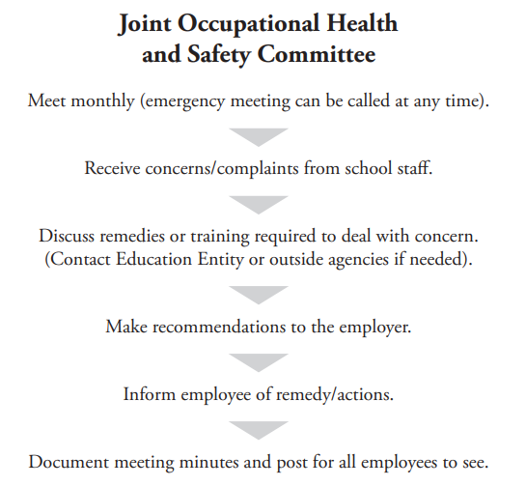
Notes:
JOSH Committees play a very important role in site based health and safety. School JOHS Committees should have a NSTU representative and we encourage the NSTU Rep to be person. Along with the handout, here are some other resources to access.

Slide 20
Who do I contact at the Department of Labour and Advanced Education?
Occupational Health and Safety Division
Phone: 902-424-5400
Toll-free: 1-800-9LABOUR (1-800-952-2687)
Email: ohsdivision@novascotia.ca

Slide 21
When you should call
You can call to request services, ask for information or report workplace health and safety issues or public space issues in relation to technical equipment. The line is active 24 hours a day, 7 days a week.

Slide 22
Case Studies
This is an opportunity to share your own experiences, and together we can explore effective ways to address and navigate each scenario.
Let’s discuss possible next steps and approaches for resolving each situation.

Slide 23
VIOLENCE IN THE WORKPLACE

Slide 24
Violence in the Workplace Regulations
Violence is an occupational health and safety issue
The regulations do not diminish the responsibility of all workplace parties to recognize violence as an occupational health and safety hazard in carrying out their precautions and duties under the Act.
An employer or employee in the workplace has a duty to report all incidents of violence in a workplace to the employer.
The regulations apply to education services provided by institutions, including a school governed by the Education Act.

Slide 25
Violence risk assessment
An employer must conduct a violence risk assessment for each of their workplaces to determine if there is a risk of violence in the workplace and prepare a written report concerning the violence risk assessment detailing the extent and nature of any risk identified by the assessment.
An employer must consult with any JOHS committee / safety representative established at the workplace when conducting a violence risk assessment and must provide the committee with a copy of the written report of the assessment.
Notes:
P

Slide 26
Documentation, investigation and actions to prevent reoccurrence
An employer must ensure that incidents of violence are documented and promptly investigated to determine their causes and the actions needed to prevent reoccurrence.

Slide 27
Violence risk assessment
In conducting a violence risk assessment, an employer must take all of the following into consideration:
(a) violence that has occurred in the workplace in the past;
(b) violence that is known to occur in similar workplaces;
(c) the circumstances in which work takes place;
(d) the interactions that occur in the course of performing work;
(e) the physical location and layout of the workplace.
Notes:
P

Slide 28
When new violence risk assessment required?
An employer must conduct a new violence risk assessment for each of their workplaces at least every 5 years.
When there is a significant change in the circumstances in which work takes place (e.g., the interactions that occur while performing work, the physical location or layout of the workplace)

Slide 29
Workplace violence prevention plan
An employer must
establish and implement a workplace violence prevention plan for each workplace for which a significant risk of violence is identified
take and document reasonable measures to minimize and, to the extent possible, eliminate the risk of violence in the workplace
establish and document procedures for providing employees with the information and training

Slide 30
Workplace violence prevention plan
An employer must also
establish and document procedures for reporting, documenting and investigating incidents of violence
consult with any committee established at the workplace when establishing, reviewing or revising a workplace violence prevention plan.
make a copy of the workplace violence prevention plan available for examination by any employee

Slide 31
Information that must be provided to employees
An employer must provide an employee who is exposed to a significant risk of violence with information on the nature and extent of the risk and on any factors that may increase or decrease the extent of the risk.
Except as prohibited by law, the duty to provide information to an employee includes a duty to provide information related to a risk of violence from a person who has a history of violent behaviour if that person is likely to be encountered by the employee.

Slide 32
Dealing with employees exposed to or affected by violence
An employer must provide an employee who has been exposed to or affected by violence at the workplace with an appropriate debriefing and must advise the employee to consult a health professional of the employee’s choice for treatment or counseling.

Slide 33
Right to Refuse Work
Key Principle​
Practical Response​
A teacher may exercise the right to refuse unsafe work, but the right is directed at the specific hazard or unsafe condition. It does not automatically mean the employee leaves work for the day.​
Management addresses the concern while maintaining operations. Examples:​
• Move the class to another room​
• Reassign duties within the school​
• Temporarily assign work at another site​
Four-part test
1. Honest belief that health or well-being is endangered​
Takeaway: The remedy should be proportionate to the specific safety concern. When possible, work continues through relocation, reassignment, or other corrective measures that remove the unsafe condition.​
2. Concern communicated reasonably to a supervisor​
3. Belief is reasonable in the circumstances
4. Danger is serious enough to justify the action taken​
Notes:
You must show up to exercise this right – you can’t phone it in.

Slide 34
Right to Refuse Work
The employer fixes the problem to the employee’s satisfaction.
If an employee is instructed to do work that they believe is dangerous to themselves or anyone else in the workplace, they can refuse to do the work until:
The Joint Occupational Health and Safety Committee has investigated the situation, and all members of the Committee advise the employee to do the work.
A Department of Labour and Advanced Education OHS Officer investigates the situation and advises the employee to do the work.

Slide 35
Right to Refuse Work
If an employee refuses to do work, they should:
Report to a supervisor that they refuse to do the work.
If the problem is not fixed to the employee’s satisfaction, report it to the Joint Occupational Health and Safety Committee
If the problem is still not fixed to the employee’s satisfaction, report it to the Department of Labour and Advanced Education.

Slide 36
Right to Refuse Work
When an employee refuses to do work, that employee has the right to participate in the investigation along with the Joint Occupational Health and Safety Committee or Department of Labour and Advanced Education OHS Officer. During the refusal, the employee must be paid their regular wages.

Slide 37
Right to Refuse Work
When an employee refuses to do work, the employer is allowed to give them other work to do.
Also, when one employee refuses to do work, the employer has the right to give the work to another employee, provided the second employee is made aware of:
The first employee’s refusal,
The first employee’s reason for refusing, and
The second employee’s right to refuse.

Slide 38
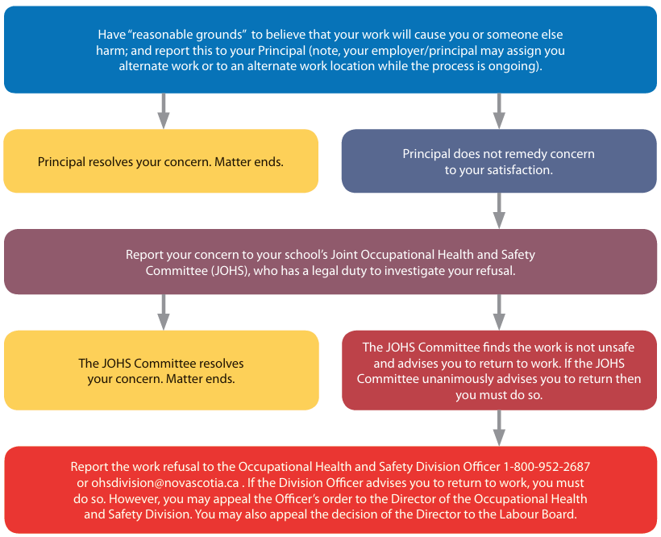
How do Teachers exercise this right?
To exercise this right a teacher must proceed according to these steps:

Slide 39

PSYCHOLOGICAL WELL-BEING

Slide 40
Recent Changes — Stronger Workplaces Act (Sep 1, 2025)
Psychological health and safety now explicitly protected
Employers must have a harassment prevention policy
New government authority to create harassment regulations
"Reprisal" replaces "discriminatory action" — protections for speaking up
Quick discussion (2 min):
"What does unsafe work look like in a school context — physical or psychological?"

Slide 41
What Is Psychological Safety?
WCB Nova Scotia / Nova Scotia Department of Labour, Skills and Immigration describe a psychologically safe workplace as one that “promotes workers' mental well-being and actively prevents harm to their psychological health. It's an environment where people feel respected, supported, and safe to speak up without fear of blame or humiliation."

Slide 42
What does Psychological Safety look like in schools?
Harassment by administrators or colleagues
Unreasonable workloads or expectations
Lack of support following a critical incident
Feeling unsafe to raise concerns without fear of retaliation – not reporting violence, harassment
Not seeking accommodation

Slide 43
When Psychological Safety Is Missing
Warning Signs
Members stay silent
Near misses are not reported
Fear of reprisal
Normalization of unsafe conditions
"That's just part of the job"
Reflection Question
Where do you see this happening?

Slide 44
Building Psychological Safety: What Leaders Can Do
✓ Listen first
✓ Validate concerns
✓ Ask curious questions
✓ Encourage reporting
✓ Normalize speaking up
✓ Protect confidentiality
✓ Challenge reprisals
Psychological safety is what allows workers to exercise their OHS rights.

Slide 45
Psychological Safety and OHS Rights
Right | Psychological Safety Connection
Know | Comfortable asking questions
Participate | Comfortable sharing ideas
Refuse | Comfortable speaking up

Slide 46
Group Exercise: "From Concern to Action“
Form 3 groups of 4
Each group will consider a scenario
Report Back - 2 minutes per group

Slide 47

Supporting Members : What Can Local Leaders Do Tomorrow?
Immediate Actions
Ask members about concerns
Encourage reporting
Attend OHS meetings
Follow up on unresolved issues
Share OHS resources regularly

Slide 48
Common OHS Myths
Myth "Only physical injuries count as OHS."
Reality Psychological health hazards matter too.

Slide 49
Common OHS Myths
Myth "Reporting will cause trouble."
Reality The Act contains protections against discrimination and reprisal

Slide 50
Common OHS Myths
Myth "The committee will deal with it."
Reality Everyone participates in safety.

Slide 51


My Mentis – Mentimeter
When you think about health and safety in schools, what is the first word that comes to mind?
Which OHS right is least understood by members
Making OHS rights easier to exercise

Slide 52
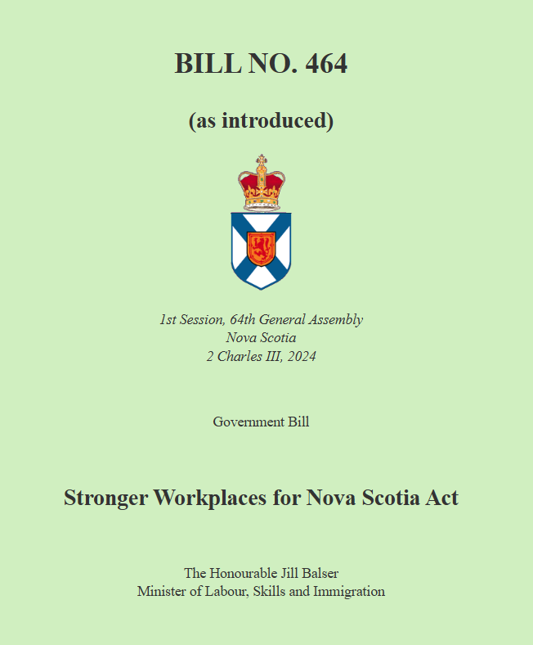
Stronger Workplaces Act
September 2025

Slide 53
Broadened Health and Safety Scope
  The Act expands workplace safety to include physical and psychological well-being, reflecting modern workplace realities.
Responsibility for Psychological Harm
  Employers must now protect workers from psychological harm like stress, bullying, and harassment.
Harassment as Safety Issue
  Workplace harassment is framed as a safety hazard requiring serious management and prevention.
Enhanced Worker Protections
  The updated Act strengthens protections and encourages safer reporting and comprehensive risk management.
Expanding the Definition of Workplace Health and Safety
(Sep 2025)
Notes:
Occupational Health and Safety (OH&S) framework now includes both physical and psychological well-being. Historically, OH&S legislation focused primarily on preventing physical injuries, such as slips, falls, or exposure to hazardous substances. Under the updated approach, employers are now clearly responsible for protecting workers from psychological harm, including stressors and behaviours that may negatively affect mental health.
This change reflects the reality of modern workplaces, where issues such as workplace harassment, bullying, and chronic stress can cause serious harm comparable to physical injuries. Psychological injuries may result in anxiety, depression, reduced productivity, and extended absences from work. By explicitly including psychological health and safety, the Act emphasizes prevention, early identification of risks, and the creation of healthier work environments. Employers must consider how work organization, interpersonal behaviour, and management practices may impact mental well-being.
Another key element of this expanded definition is the introduction of clearer expectations around workplace harassment. The Act identifies harassment as a health and safety issue rather than solely a human resources concern. This framing reinforces that harassment prevention is not optional and must be managed with the same seriousness as other safety hazards. Recognizing psychological health within OH&S also supports a culture where workers feel safer reporting concerns, knowing that the law acknowledges these risks as legitimate and actionable.

Slide 54
Harassment Prevention Policy
  Employers must implement policies to proactively address harassment and outline clear reporting procedures.
Psychological Health and Safety
  Workplace culture and supervision should reduce psychological risks like stress and negative interactions.
Worker Protections and Rights
  Workers have the right to refuse unsafe work and report hazards without fear of retaliation.
Proactive OH&S Approach
  Employers must plan and train to manage both physical and psychological workplace risks effectively.
Harassment Prevention and Psychological Safety Duties

Slide 55
Regulatory Authority for Harassment
  The Act empowers government to establish detailed workplace harassment regulations for consistent prevention practices.
Clear Guidelines for Employers
  Regulations provide employers with clear standards on policy content, processes, and implementation to ensure accountability.
Protection Against Reprisals
  Terminology update from 'discriminatory action' to 'reprisal' strengthens protections for workers reporting safety concerns.
Safer Reporting Culture
  Stronger protections encourage workers to report hazards, fostering safer and more respectful workplaces.
Harassment Regulations and Protection Against Reprisals

Slide 56
Discriminatory Action/Reprisals
An employer or union cannot take, or threaten to take, action that affects an employee’s job because:
They have complied with the Act or regulations or contacted the Department of Labour and Advanced Education.
They have spoken to the JOHS Committee or serve on the Committee.
They have refused to do work that they believe is unsafe or unhealthy.
They are going to testify or have testified in court about violations
They have reported a health and safety violation in the workplace.

Slide 57
RESOURCES

Slide 58
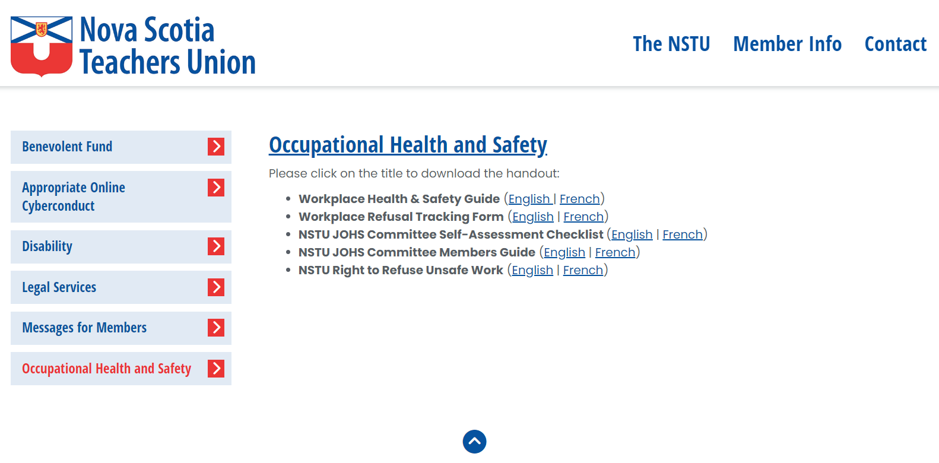

Notes:
On the NSTU website there are resources to support those teachers who serve on their site’s JOHSC

Slide 59
How can the NSTU assist?
Help guide members through the process
Work with the employer’s Human Resources to address concerns
Teachers’ Provincial Agreement Article 63 - Class Climate
Regional Collective Agreement - School Climate or Violence Against Teachers article
Teachers’ Provincial Agreement Article 26: Leave for Injury on Duty (IOD) support
Member Assistance Program to assist members when they return to work after an injury

Slide 60
Final Reflection
"What is one action you will take in your Local to strengthen health and safety this year?"

